Slide 1
Second Life: An Introduction to a pioneering virtual world
COMP 7570/ARCG 6021
Ryan Schultz – January 31st, 2024

Slide 2
Tip: Camera Controls
Look for the eye button in the row of buttons along the bottom of your Firestorm viewer and click on it. This will bring up your camera controls (the default view is rear view, over your avatar’s shoulder).
Tip: If you press down the Alt key while clicking on something in Second Life, your camera view will centre on it. You can then use the scroll wheel on your mouse to get a closer (or further away) look!

Slide 3
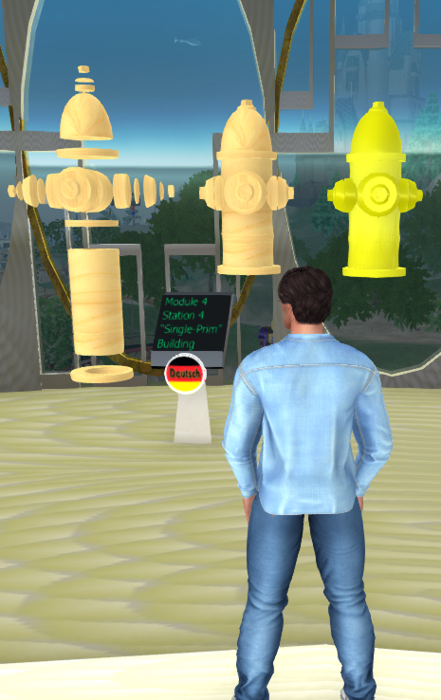
My Presentation
What is Second Life?
Virtual World Concepts
Background and History
Avatars and Avatar Customization
Ways to build in Second Life
Using in-world building tools (primitives)
Using external 3D content creation tools and uploading mesh models
Second Life’s Impact
Why didn’t Second Life get more popular?
Why didn’t Second Life die?
The Future

Slide 4
What is Second Life?

Slide 5
Celia Pearce, Bobby Blackburn, and Carl Symborski, in their Virtual Worlds Survey Report (2015), write about six key features that all virtual worlds share: Source: https://cpandfriends.com/wp-content/uploads/2015/03/vwsurveyreport_final_publicationedition1.pdf
“There are many different types of virtual worlds; however, according to virtual worlds experts from both academia and industry, virtual worlds have the following features in common:
Shared Space: the world allows many users to participate at once.
Graphical User Interface: the world depicts space visually, ranging in style from 2D “cartoon” imagery to more immersive 3D environments.
Immediacy: interaction takes place in real time.
Interactivity: the world allows users to alter, develop, build, or submit customized content.
Persistence: the world’s existence continues regardless of whether individual users are logged in.
Socialization/Community: the world allows and encourages the formation of in-world social groups like teams, guilds, clubs, cliques, housemates, neighborhoods, etc.”

Slide 6
Background and History: The Earliest Years
Linden Lab (the company that makes Second Life) was founded by Philip Rosedale in 1999
Originally, they were a hardware company focused on research and development of haptics (technology that can create an experience of touch by applying forces, vibrations, or motions to the user)
The company needed a virtual world in which to test their hardware, so they created what was then called LindenWorld in 2001 (watch this August 2001 video of LindenWorld on YouTube to get a sense of what this testbed platform was like; it is very different from what it has become after 20 years!)
Eventually, Linden Lab abandoned hardware development altogether and decided to focus on continuing to build the virtual world they had created as a testbed.
The first “resident” (the name Linden Lab employees give to non-employee users) joined on the first day of alpha testing on March 12, 2002
After a series of beta test periods, LindenWorld (renamed Second Life) officially launched to the public on June 23, 2003
To put this into some context, Second Life launched a year before Facebook (February 4, 2004) and four years before the launch of the iPhone (June 29, 2007)

Slide 7
Background and History: Economy and Currency
Second Life launched without an economy or an in-world currency. The Linden dollar (L$) was introduced by the end of 2003, and the LindeX currency exchange followed about two years later.
The LindeX is a service created and run by Linden Lab that allows residents to trade Linden dollars for U.S. dollars, and vice versa. This meant that content creators could earn income in world (in Linden dollars), and then convert their L$ to US$ and cash out their profits. This led to one of the reasons Second Life is still in operation 20 years later: people making money!
Many people began earning a part-time or even full-time income by making and selling virtual goods and services to other avatars, setting up stores in Second Life.
While in the beginning, Second Life's business model was primarily based on paid memberships (which later evolved into 3 levels of Premium accounts), the focus soon shifted to land sales. Residents became able to acquire and rent land, which in turn also became a business model for some entrepreneurial residents. (Interestingly, the trend has gone back to more of a focus on paid memberships and fees as the primary source of income, with a gradual lowering of land costs over time, as physical server farms migrated to the cloud.)

Slide 8
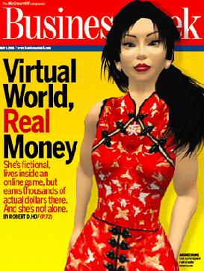
Background and History: The “Gold Rush” Years
In May 2006, a Second Life avatar named Anshe Chung graced the cover of Businessweek magazine, which told the story of how she (in real life, a Chinese-German woman named Ailin Graef) became the first online personality to achieve a net worth exceeding one million U.S. dollars from profits entirely earned inside a virtual world (by buying, developing and subdividing Second Life regions and selling or renting them out to other users). Her land business was so successful that it persists to this day!
The news sparked a two-year “gold rush” period (2006-2008), as people realized that they, too, could actually earn real money in Second Life, and they began joining the platform in ever-increasing numbers. Dozens of real-life companies and brands decided to set up shop in Second Life: Dell, Toyota, Nissan, Sun Microsystems, IBM, even American Apparel and Playboy.
Unfortunately, this corporate heyday did not last long. By the end of 2008, most real-world corporations were pulling out, not seeing the benefit (i.e. profit) in running operations on a virtual world, especially during a grueling recession.

Slide 9
Background and History: The Later Years
Despite the lack of corporate interest in Second Life, the platform continued to attract new users. By 2013, ten years after its founding, Second Life had over one million Monthly Active Users (MAU; that is, residents who visited SL at least once a month), making 3.2 billion U.S. dollars’ worth of transactions within the Second Life economy, with over 2.1 million user-created items for sale. This thriving ecosystem is one of the reasons why Second Life persists to this day, and it is still a profitable business for Linden Lab, despite the news media reporting that Second Life was “dead.”
Most SL businesses are one or two-person “Mom and Pop” shops.
Second Life did have more success marketing itself to educational users than corporate users, and for a while, many universities and colleges had land in, or offered courses in, Second Life. However, in 2011, Linden Lab’s then-CEO decided to remove the 50% nonprofit and educational discount on land rental, without any advance warning, which forced many educational and non-profit institutions to give up their regions. Linden Lab finally re-established the discount three years later, but the damage was already done, and relatively few educational institutions have bothered to come back into Second Life.
While Second Life’s userbase has slowly gone down over time, Second Life’s MAU jumped 50% (from 600,000 to 900,000) during the recent coronavirus pandemic and subsequent lockdown.

Slide 10
Avatars
Notes:
Consider talking about:
Economy
Geography
Research
Virtual worlds and real life

Slide 11
Avatar Customization

Slide 12
Avatars: the Divorce Between SL versus RL
Unlike, say, Facebook, where your profile is strongly encouraged (even enforced) to be associated with your real-life (RL) identity, most Second Life (SL) users tend to explicitly keep their SL and RL separate.
While this separation can lead to anti-social behaviour (trolling, griefing, and harassment, particularly of women and female-identifying avatars), many people find the experience to be liberating. As I wrote on my blog in 2020:
“And it makes me wonder: just how successful will the new Facebook Horizon be, if they insist that you be, essentially, your own rather boring self, linked to your personal Facebook account, and unable to throw on the guise of somebody else? The very thought would horrify most Second Life users, who are so used to being somebody else, and hiding behind an avatar name, and often roleplaying somebody (or something) completely different from their real lives…Fourteen years of Second Life has taught me that the ability to be somebody else—walk around in someone else’s skin—can be an insightful, instructive, transformative, and even delightful experience.”

Slide 13
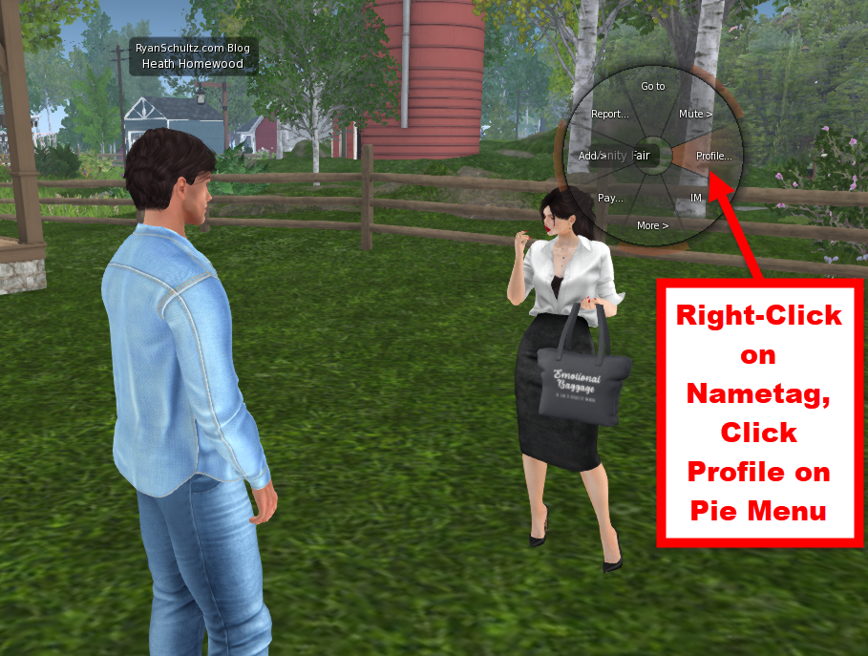
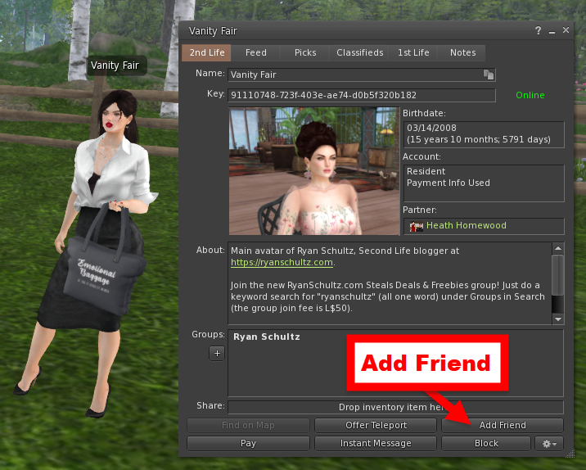
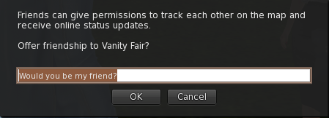
Avatars: Avatar Profiles and Adding Friends
Right-click on another avatar’s nametag over their head to see their user profile. Click on the Add Friend button at the bottom of the profile to add them as a friend.

Slide 14
Avatars: Partners and Groups
You can also “partner” with another avatar of either sex. Second Life weddings are big business; there are even companies in SL which specialize in wedding venues, photography, and even videography!
Over the 20 years of Second Life’s history, many real-life couples first met each other in the virtual world, then took the relationship from Second Life to real life. (Search YouTube for the series Love Made in Second Life, which profiles some of these couples.)
Avatars can belong to groups. Any avatar can create a group, and group members can have different roles and responsibilities (e.g. the ability to invite new members to the group; the ability to post notices).
Groups have a notice section, and often Second Life stores will have a store group that you can join to stay on top of news such as store sales, new releases, group gifts, etc.
Many groups also allow their members to text chat with each other (in a separate window from nearby text chat).
It is also possible to mute, block, and even completely derender another avatar who is bothering you (don’t you wish you could do that in real life?)

Slide 15
Two Ways to Build in Second Life
Using the in-world primitive (prim) building tools (2003-date, although since the advent of mesh in Second Life in 2011, this is now a less popular method of creating content).
Creating a mesh model using a third-party 3D content creation tool (e.g. Blender), then uploading the model to Second Life (2011-date, and currently the most popular way to create content).
In order to build, you must be on Second Life land which permits building (either land you own or rent, or a public sandbox). It is possible to do collaborative building in SL (i.e. two or more avatars working together to build something).

Slide 16
A Comparison of the Two Ways to Build in Second Life
The Old Way: In-World Prim Building
Free (only requires some land with build rights, or you could use a public sandbox)
Accessible to anybody (built into the SL viewer)
Relatively easy to understand and use
Tends to result in poorly-optimized models (i.e. high Land Impact/LI), compared to the new way
Tends to result in models which are not as aesthetically pleasing as those created the new way
The New Way: Using a Third-Party 3D Content Creation Tool and Uploading a Mesh Model
Not free; you must provide a method of payment for upload fees (usually a credit card); also requires land with build rights for testing
You must agree to SL’s intellectual properties terms
May require expensive software (although Blender and some other tools are free!)
Requires a significant investment in learning how to use the tools well (for example, learning how to optimize your mesh model so that its Land Impact is significantly lower than a similar prim-built model, while offering still more detail)
If you become good at it, you can create content which is desirable to consumers, open a store, and even make some money from it!
Creating mesh apparel for avatars requires a particularly complex skill set (e.g. rigging clothes to various brands of mesh bodies), which has a VERY steep learning curve.

Slide 17
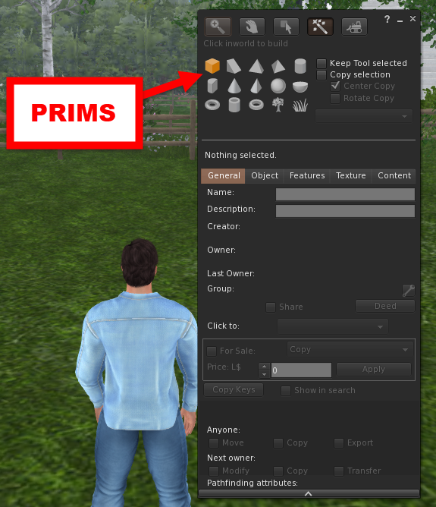
Building Using the In-World Build Tools
In Firestorm, right-click on the ground, and select Create from the pie menu. Your cursor will change to a magic wand, and you will see a menu of prims.

Slide 18
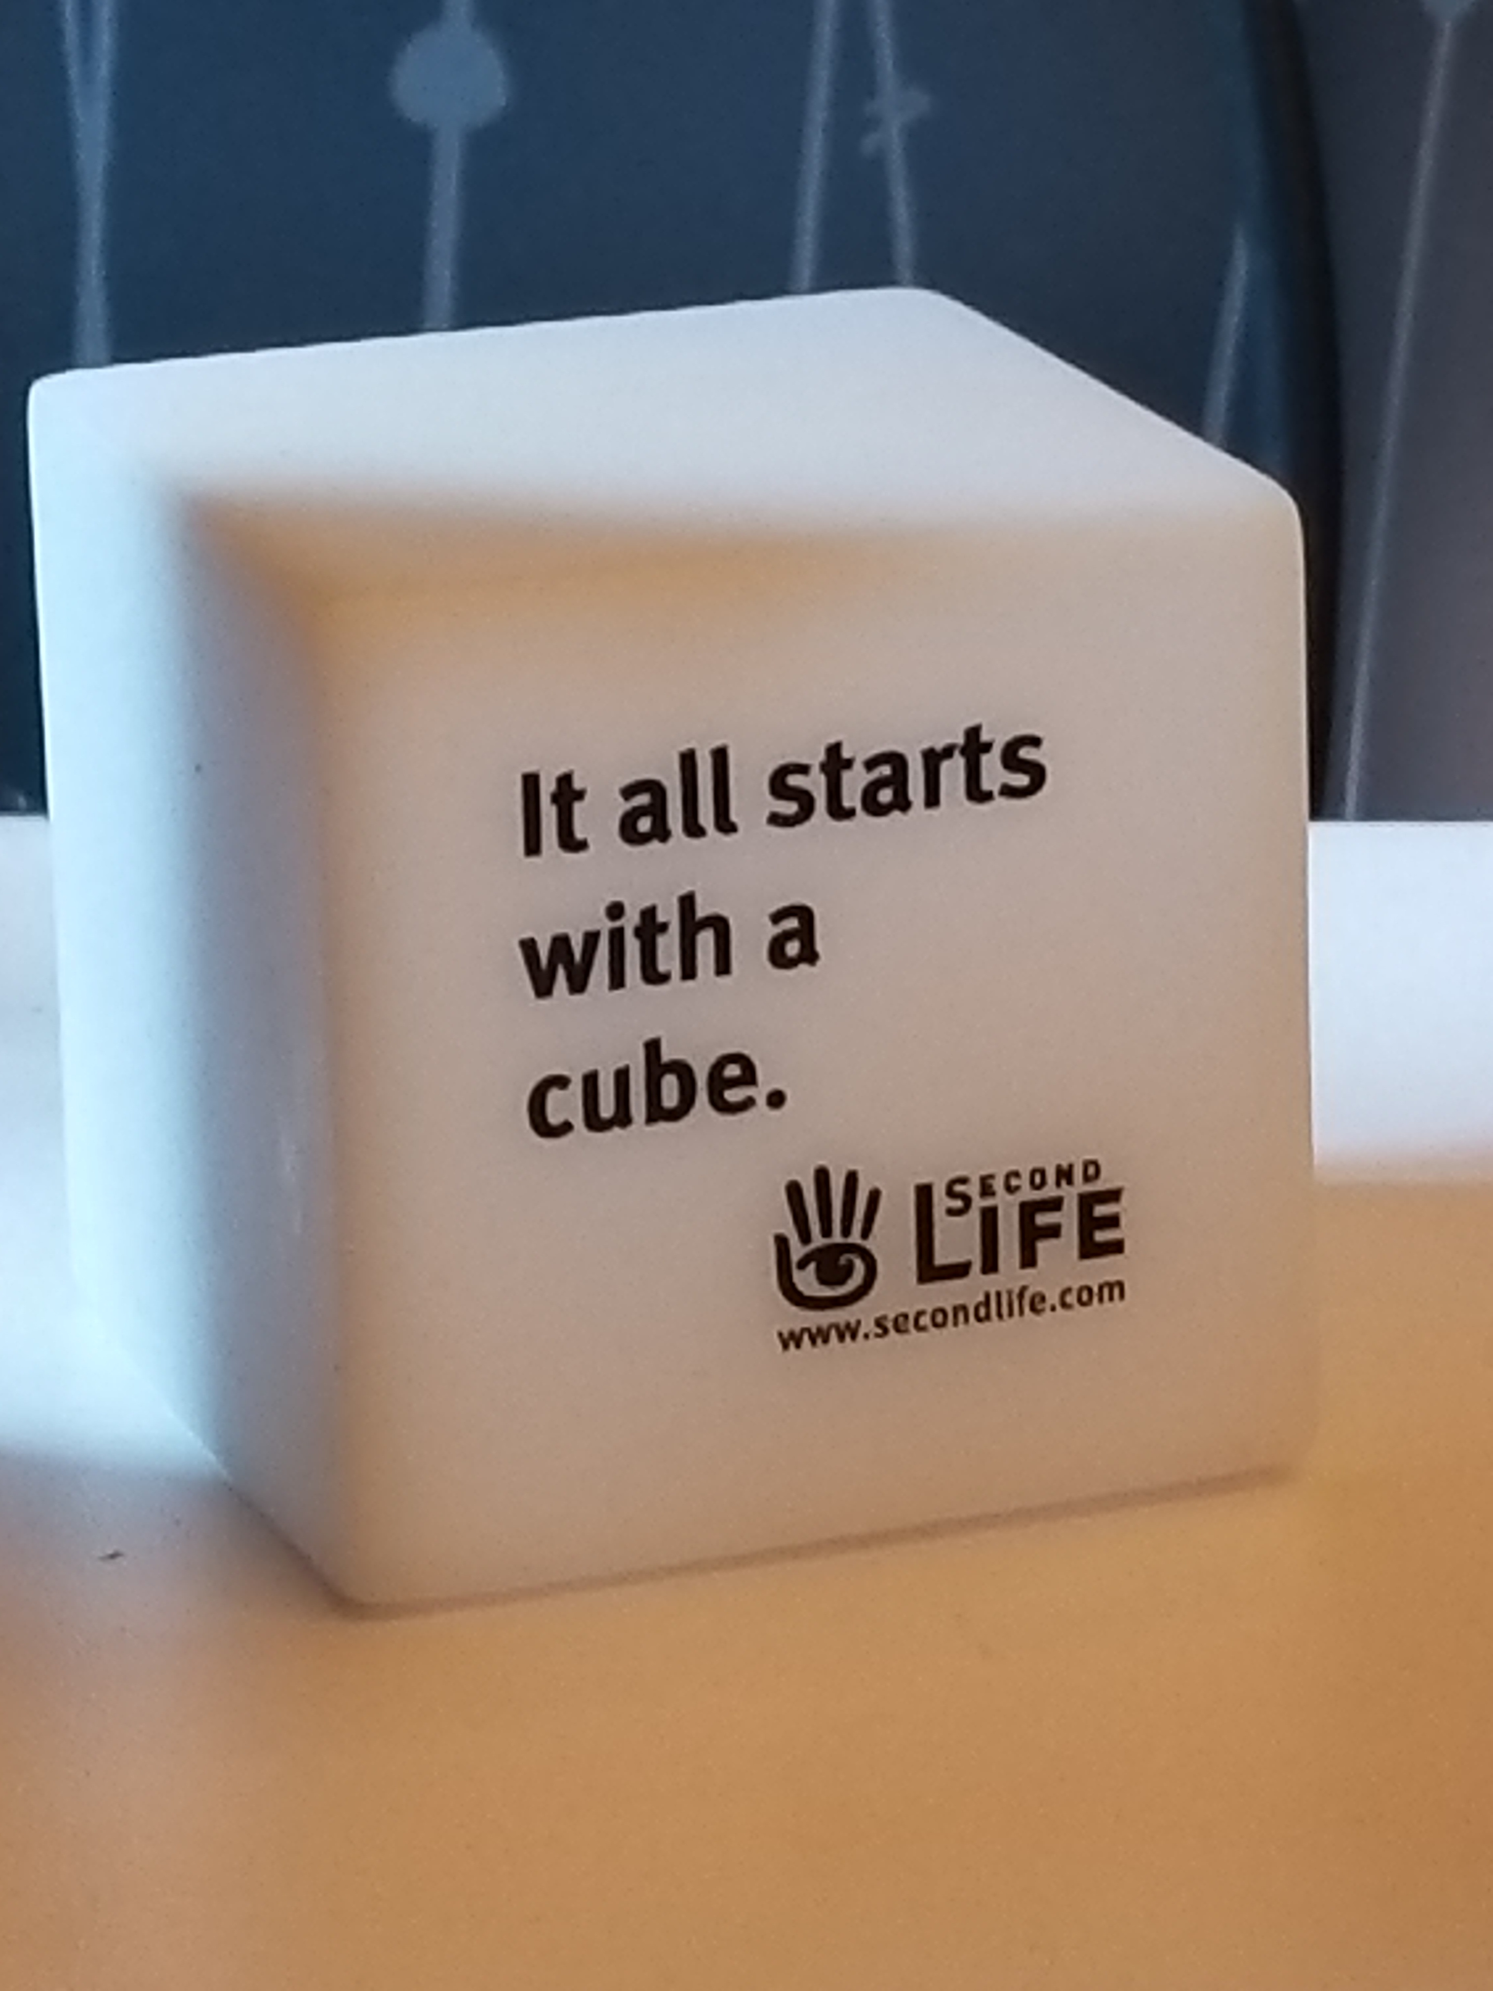
What are prims?
Primitives (prims) are the original building blocks of Second Life, and in the early years of the virtual world, everything was built in-world from prims, using the in-world tools within the Second Life viewer software.
Default prim shapes include cube, prism, pyramid, tetrahedron, cylinder, hemicylinder, cone, hemicone, sphere, hemisphere, torus, tube, and ring, plus a variety of low-poly trees and grasses for landscaping purposes.
Prims can be moved, rotated, and stretched/resized. In Edit mode, the Object tab of a prim offers several additional options for editing basic prim shapes. Prims can be copied and pasted. Prims can also be linked together to form larger objects. Scripts can be added.

Slide 19
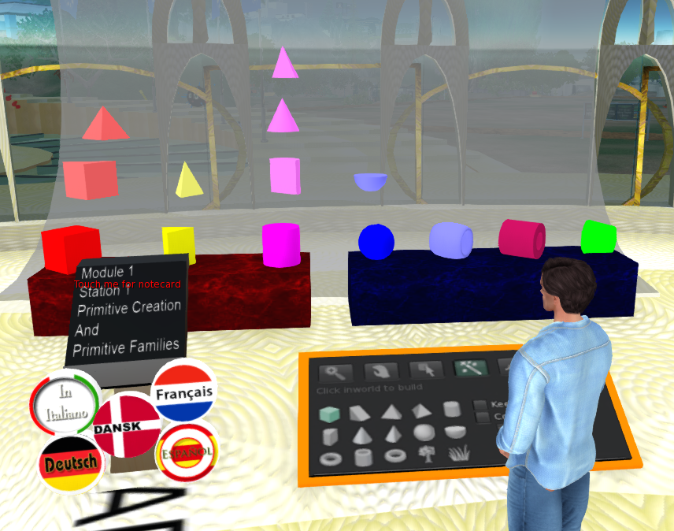
The Ivory Tower Library of Primitives
The Ivory Tower Library of Primitives is a place in Second Life where you can learn how to build using primitives (prims)

Slide 20
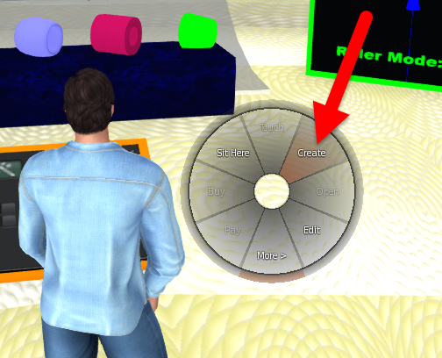
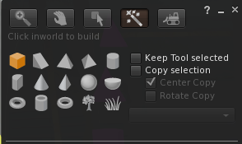
Prim Building: Creating Prims
You can do prim building only on land that permits building.
To create a prim, right click the land near you to get the pie menu and choose Create. You'll be given the prim creation menu from which you may select a variety of prims. Choose one and you'll get a magic wand cursor. Touch this cursor to the ground or on top of an existing prim and your selected prim will appear! (The default prim is a cube with a plywood texture.)

Slide 21
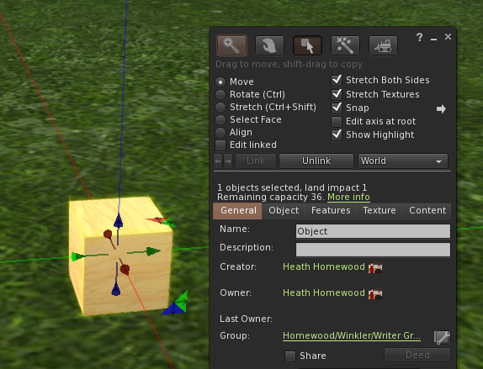
Prim Building: Moving Prims
Right-click an object and select Edit. This opens the Build window to the Object tab.
Choose Move to enable the Position function.
Click and drag the red/green/blue axes on an object to move it around.
Clicking on the red (X), green (Y), and blue (Z) arrows lets you drag the object only along those axes.

Slide 22
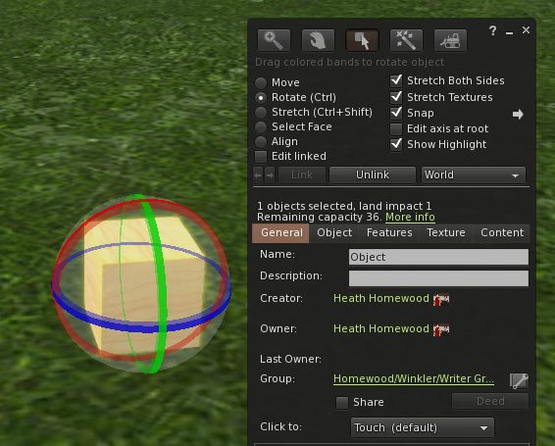
Prim Building: Rotating Prims
Right-click an object and select Edit.
Choose Rotate in the Build window to bring up the rotation sphere.
Click and drag anywhere within the sphere to rotate the object freely along all three axes.
Click and drag a specific ring (red/green/blue) to rotate the object only around that axis.

Slide 23
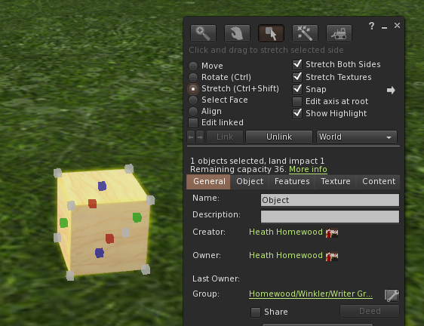
Prim Building: Resizing/Stretching Prims
Right-click an object and select Edit.
Choose Stretch from the Build window to bring up the sizing box.
Click and drag one of the white corner boxes to scale the entire object proportionally.
Click and drag a red, green or blue box to re-size a prim's length, width or height (respectively) without changing the other dimensions.

Slide 24
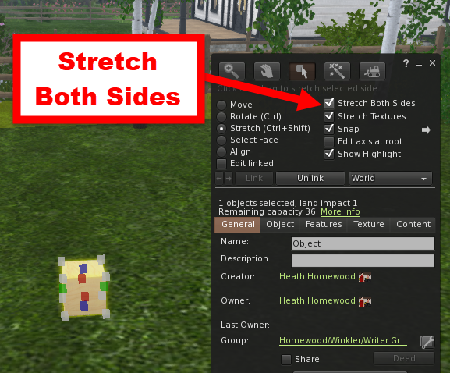
Prim Building: Stretch Both Sides
Click or unclick the Stretch Both Sides checkbox at the top of the edit window to cause the prim to stretch either in one direction only, or both directions along the X,Y or Z dimension you are stretching it on. For symmetrical results when you're trying to keep a set of prims aligned, use Stretch Both Sides. When you're trying to adjust the size of an object to match the prims around it, unclicking Stretch Both Sides will often let you work more quickly.

Slide 25
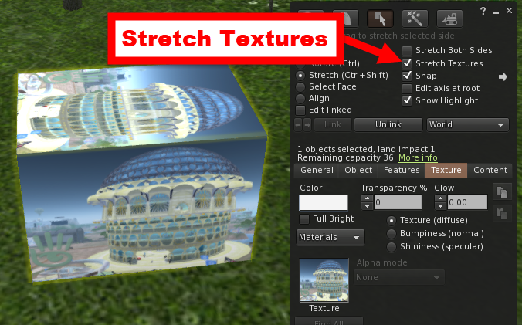
Prim Building: Stretch Textures
On your edit window on the right hand side is a checkbox that says Stretch Textures. When you stretch/resize a prim, this checkbox determines the fate of that prim's texture. If you have it set to stretch, the texture will resize itself to accommodate what you are doing to the prim. If you have this box unchecked, the texture will stay the same size and simply repeat itself all over the prim to cover it.
Here, I unchecked Stretch Both Sides, then stretched only one side of this cube. Because I checked the Stretch Textures box, the texture stretches with the shape.

Slide 26
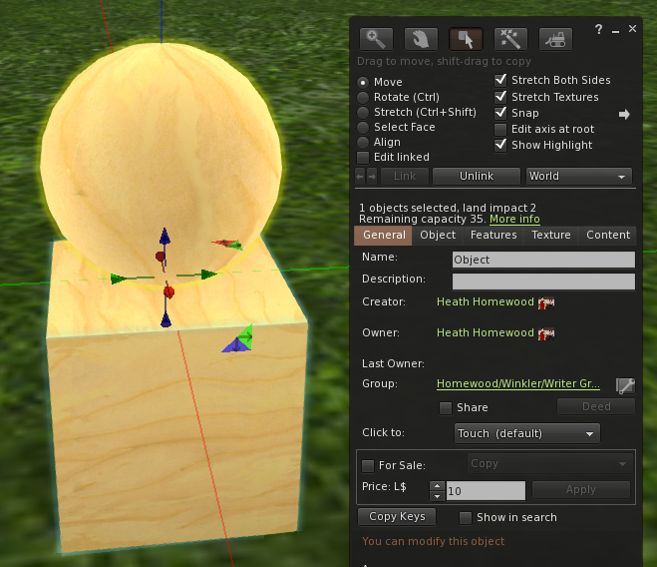
Prim Building: Linking Prims
Create two or more prims, then select them all at the same time (you need to be in Edit mode for this to work). Press down the shift button on your keyboard then left click your prims one at a time; they should all glow yellow in edit mode. Hold down the CTRL and the L buttons on your keyboard (CTRL-L; hold down the CTRL button first).
To unlink your linked set of prims, hold down CTRL - SHIFT then L on your keyboard (start with the CTRL key).

Slide 27
Prim Building: More on Linking Prims
You can link several primitives (prims) together to create one cohesive object. A linked object is, for all intents and purposes, considered one object. It has one name, acts as one object (for example, if physics are enabled on it), and it cannot be broken apart unless you Unlink it. However, a linked object still counts as the sum of its prims when determining your land impact (LI).
One prim of the object is considered the parent or root link. The name of the parent link is the name of the whole linked object. The inventory of the root prim is, for most purposes, the inventory of the whole object. The center (or origin) of the root prim is the center of the whole object, even if the root prim is not the physical center of the object itself. Make the most important prim and/or scripted prim (root) the last one you select (such as the seat of a vehicle). Vehicle scripts look at the root prim's orientation to determine the "front" of the vehicle. As a result, it is important which prim you select as the root prim.

Slide 28
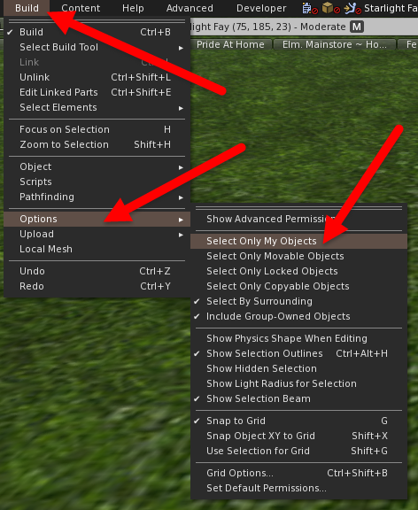
Prim Building: Selecting Multiple Prims
CLICK SELECTION: Holding down SHIFT while clicking other prims in Edit mode will select several prims in a sequence (before you link them).
MASS SELECTION: This is a great technique to quickly select many prims at the same time. Left click your mouse on water, the sky, the ground or even a prim, and while holding down the left mouse button, drag your cursor diagonally. A translucent, golden rectangle will form. Prims that fall within this golden rectangle will be selected. Again, you must be in Edit mode for this to work!
NOTE: It’s a good idea to click on the Build menu, click on Options, then check Select Only My Objects before running a Mass Selection (see image), so you don’t accidentally include prims that are not yours!

Slide 29
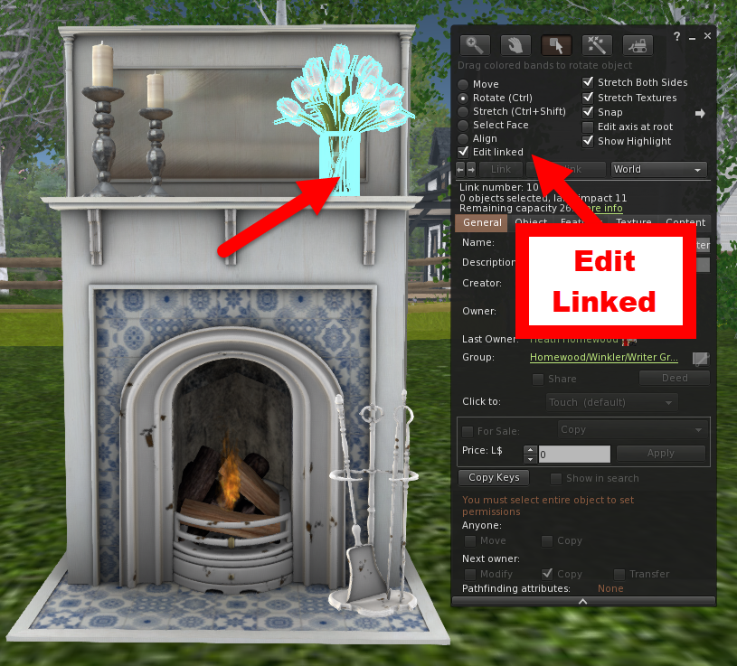
Prim Building: Editing a Linked Prim
You can edit individual prims in a linked set by selecting Edit Linked while in Edit mode (see image). You will be able to do anything with this prim you could normally do with an unlinked prim, except delete or copy it. You may also select multiple prims while in edit linked parts using the SHIFT key while clicking, then scale them or unlink them all at once.
In this case, I wanted to select only the vase of tulips from this linke-mesh fireplace set, which I bought.

Slide 30
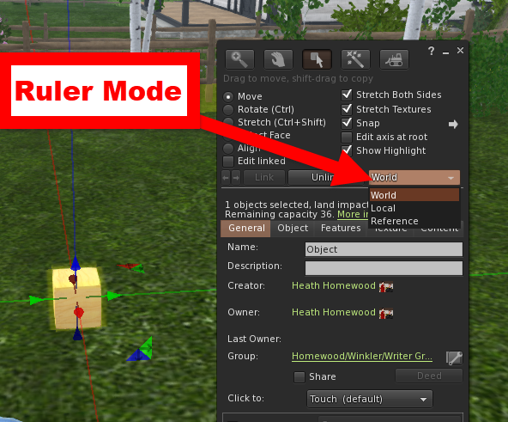
Prim Building: Grid/Ruler Mode
If you look to the right side of the Edit Window, you'll see Ruler Mode with a drop-down menu giving you three choices of rulers, which can be used to align your prim building work:
World: This ruler mode gives you the XYZ orientation of the whole world and where your prim is in that space.
Local: This ruler mode gives you the XYZ orientation of the prim or object you are manipulating
Reference: Pull out a prim, rotate it a bit, get out of chat mode (hit ESC) and type SHIFT-G. While in Ruler Mode Reference, your ruler will be oriented to this prim, no matter what prim you select. If you delete the reference prim, your ruler mode will revert to World.

Slide 31
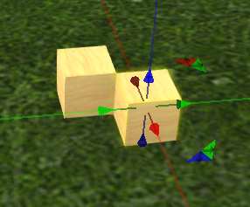
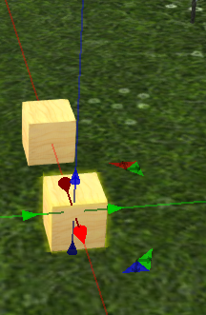
Prim Building: Copying a Prim
Ctrl-D Copying
There are two ways to copy a prim:
CTRL-D Duplication: If you select a prim in Edit mode and hit CTRL-D (for duplicate) on the keyboard, you will make a copy. It's a very odd feature; the duplicate seems to appear half a meter away from the original on both the positive X and Y directions. In other words, with a cube you get a sort of sidewise staircase effect. If the object is larger than half a meter, a copy will still be materialized exactly .5m X and .5m Y away. Each subsequent copy will probably interpenetrate with the last.
Shift-Drag Copying: Select a prim, grasp one of its arrow selection handles, hold down the shift key and drag it slowly in the direction of that arrow. This will copy the prim and leave the copy in its former place, while you are moving the original prim by its handle (this is important, remember...you are moving the original, the copy has been rezzed in its original place). If you stop moving and start again with the shift button depressed, you will create another copy. This method boasts many advantages: Each prim copied from the original is already in perfect alignment with the original prim position.
Shift-Drag Copying

Slide 32
The Undo Feature (Ctrl-Z)
You must specifically select an object in Edit mode to undo changes to that object. (You'll see the positioning arrows and a yellow silhouette glow.)
Undo primarily reverts changes made to the position, size, and rotation of an object. For example, if you accidentally move a sofa inside a wall, undo snaps it back to where it was last.
If you change the position, size, or rotation of an object using the numerical entry fields in the Edit window's Object tab, you must click the object again to bring it into focus and make Undo work.
Each object has its own independent "chain of undos” which remembers multiple steps.
Since this data is stored on Linden Lab’s servers, you should be able revert changes to objects inworld even after logging out and in again.
Undo doesn't work if you have:
Changed any of the texture settings on an object. (It won't switch back to the previous setting.)
Deleted an object. (It won't bring it back inworld.)
Added contents to an object. (If you drag a no-copy object from inventory into another object's contents, selecting Undo won't take it out.)

Slide 33
More Prim Modification Tools: Path Cutting, Hollow, Taper, Twist, Top Shear, Dimple, etc.
There are many other prim modification tools! Among them are:
Path Cut (begin/end): Takes out a slice of the object around its local X-axis (except for boxes and cylinders, which have slices taken from the Z-axis). You can specify where the cut starts and ends.
Hollow: Puts a hollow center in the object starting from the center of the shape and expanding out. You can specify what percentage of the radius is hollow.
Twist (begin/end): Puts twists into the object, warping its shape as well as texture alignment.
Taper: Reduces the size of the top or bottom sides (x or y axes, negative or positive) of the prim.
Top Shear: Shifts (shears/skews) the top surface of the object away from the bottom. You can shift the X and Y axes separately.
Dimple (begin/end): Cuts a hole in a sphere from ring of latitude (you specify the percentage) to the top or bottom of the Z axis. The dimple cuts straight to the origin of the object (leaving a cone-shaped hole).
Slice: Cuts vertical slices from your object along the Z-axis.
For more information, please refer to the Ivory Tower Library of Primitives tutorial notecards for Modules 2, 3 and 4 (the workstations on the 2nd, 3rd, and 4th floors).

Slide 34
Prim Modification Tools = Thousands of Shapes!

Slide 35
Building Using External Third-Party Tools
You can create a mesh model using a 3D content creation tool (e.g. 3ds Max, Maya, Blender, SketchUp, etc.). Any 3D modeling software will work, as long as it can output models in COLLADA (.dae) format or can create files that can be converted into COLLADA format.
Meshes may be general purpose, representing simple geometry, or rigged, in which case they also store information allowing them to be animated (animesh).
Mesh objects have Land Impact (LI), which is equivalent to one or more traditional second life prims (1 prim=1 LI). Uploading mesh models to the main Second Life grid costs Linden dollars (the upload fee is calculated in the Upload Model window in your Second Life viewer, and it is paid in Linden dollars (L$), Second Life’s in-world currency. For development and testing purposes, you can upload your content to a beta test grid instead of the main SL grid (where there is no uploading fee).

Slide 36
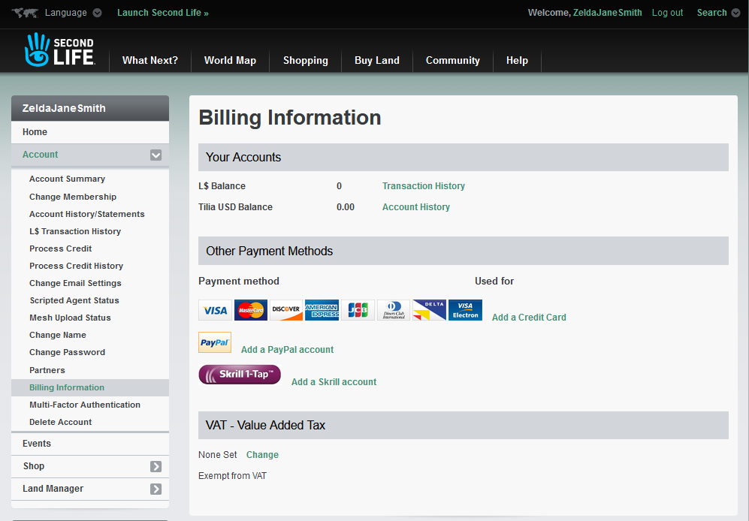
Account Requirements to Upload Mesh Models
Before you can upload mesh models, you must have accepted the IP terms on your account page, and you must also have payment information on file (i.e., a credit card, to pay for upload fees; fees are paid in Linden dollars).

Slide 37
Uploading Mesh Models in Firestorm

Slide 38
The Upload Model Window in Firestorm: Level of Detail
Levels of detail (LOD) determine how the model looks at various distances. As you get farther away from a model, it renders in less detail to boost performance.
Preview your model's automatically generated levels of detail on the Level of Detail tab by clicking High, Medium, Low, or Lowest. You can see what your model will look like in the picture on the right.

Slide 39
The Upload Model Window in Firestorm: Physics
A mesh model's physics shape defines how it collides with other objects, (i.e., your avatar won’t be able to just walk through it, but bump into it).
In most cases, you will want to choose Lowest for a physics shape, which will incur a relatively small physics cost for the mesh.
If you wish, you can choose a method to simplify the physics shape.

Slide 40
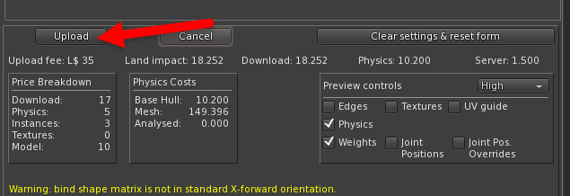
The Upload Model Window in Firestorm: Upload Options
Firestorm will calculate the weights and upload fee when you click this button under the Upload Options tab.
Note that you will need to have purchased some Linden dollars to pay the fee to upload a mesh model.

Slide 41
Rezzing a Mesh Model In-World to Check It
Your uploaded mesh model will appear as a new object (called simply Object) in your Objects folder in your Second Life inventory.
You will now want to rez (or rezz) your model, that is, to create or make an object appear in-world in Second Life.
Rezzing an object can be done by dragging it from a resident's inventory onto the ground (you must have build permissions on the land).
Then, right click on the mesh model, and select Edit from the pie menu.

Slide 42
Editing Your Prim Build or Mesh Model In-World: The General Tab
A newly created model has the default name "Object". Edit the Name box to give it a new name.
You can check the Land Impact (LI) of the object. (Resizing mesh objects can change the LI.)
You can see the avatar names of the creator (uploader), the current owner, and the previous owner, as well as the active group of the creator.
You can mark the mesh as For Sale, and set a selling price.
You can set the mesh model’s permissions for the next owner (copy/modify) and for everyone.

Slide 43
Object Permissions in Second Life
Permissions enable you to control what other people can do with the things you create. Permissions control: Copying: whether someone can make copies of your work; Modifying: whether someone can change your work; and Transferring: whether someone can give away (or sell) it to someone else.
If the object is inworld (rezzed), right-click it and choose Edit, then navigate to the General tab. If the object is in your inventory, right-click it and choose Properties.
Under the General tab, you can also set the permissions the next owner will have over the object or item. They are:
Modify: Checking this lets the next owner modify your creation. Unchecking it denies any modifications (i.e., makes it no-modify/no-mod)
Copy: Checking this lets the next owner copy your creation. If they drag the object from inventory to inworld, they will retain a copy in inventory. Unchecking it denies any copies; if they drag the object inworld it will leave their inventory until taken back into inventory.
Transfer: Checking this lets the next owner give your creation to someone else. If the object permits copying, they can sell copies. If the object does not permit copying, they can only sell the original.

Slide 44
Editing Your Prim Build or Mesh Model In-World: The Object Tab
The Object tab allows you to edit the size, shape, and location of a mesh model.
Checking the Locked box prevents you from moving an object.
Checking the Physical box will apply the model’s physics; it will be affected by collisions and gravity.
You can also adjust the position, size, and rotation of the object (but I usually use the Move, Rotate, and Stretch buttons up top).

Slide 45
Editing Your Prim Build or Mesh Model In-World: The Features Tab
The Features tab is where you indicate that the item is animesh (animated mesh), and also where you can adjust the gravity, friction, density, and bounciness of a mesh model.
The gravity setting controls how hard gravity pulls downward on the object (negative values pull up). The range is -10 to 10.

Slide 46
Editing Your Prim Build or Mesh Model In-World: The Texture Tab
Note that you will usually upload a mesh model with textures applied, but you can also upload a mesh model without any textures, then apply textures from your inventory to the mesh in-world. Clicking the Texture box will open the Pick Texture floating window, allowing you to select a new texture. You can also drag a texture from your Inventory window onto the box, or directly onto the object. Clicking the Color box will open the Color Picker floating window. Color tints selected are additive to the color of the base texture.

Slide 47
Editing Your Prim Build or Mesh Model In-World: The Texture Tab

Slide 48
Editing Your Prim Build or Mesh Model In-World: The Content Tab
The Content tab shows the internal contents of the selected object. An object can contain any type of inventory item, including other objects which in turn have nested contents. There is no set limit on the number of items that can be placed inside an object, though if it in the hundreds! However, please note that it can take some time to fetch or edit the contents if it is a high number. For example, a mesh door can have a script that opens and closes the door when touched.

Slide 49
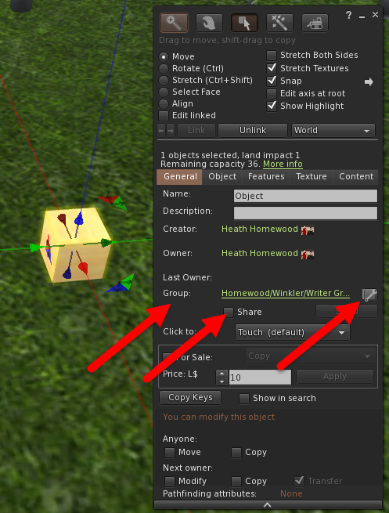
Collaborative Building in Second Life
There are a few ways to allow friends to edit your objects in Second Life. This is often referred to as collaborative building or collaborative creation. It's a useful way to let groups of people work together on a building project.
The group method
Right-click the object and choose Edit to bring up the object editor.
Click on the General tab in the editor.
Click on the Edit Wrench to the right of Group and assign the object to a group both you and your friend are in.
Check the Share checkbox below.
If you want other group members to be able to take copies of your object, you should make sure to set the next owner permissions (Modify, Copy, Transfer) appropriately.

Slide 50
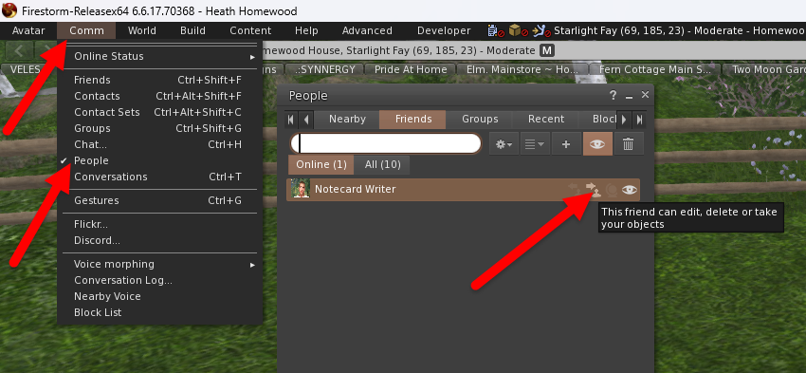
Collaborative Building in Second Life
The friend method
Open your friends list by clicking Communicate > Friends.
View your friend's profile by clicking the View profile icon on the far right by his or her name.
Click the Gear button on the upper right of the profile window that appears and select Permissions from the dropdown.
Click on the icon with the hover-over saying This friend can edit, delete or take your objects.
Click Save.
Important: This gives your friend the ability to edit all of your objects!

Slide 51
Second Life’s Impact
Second Life has had an immeasurable impact on all the virtual worlds which came after it, including the newest crop of social virtual reality platforms, such as VRChat and Rec Room.
At age 20, Second Life is the perfect model of a mature, fully-evolved virtual world, from which these newer platforms can learn from (both successes and failures!) and emulate.
The line between games and virtual worlds is continuing to blur (for example, Fortnite has hosted concerts and set up Fortnite Party Royale, an open-ended, non-combat extension).
One of the reasons that Second Life has had such extraordinary longevity and success is that people have made an investment in the (sub)cultures and communities that they belong to.
Also, Second Life has proven that people will spend a significant amount of time and money on customizing their avatars to their liking, leading to a thriving in-world economy.

Slide 52
Why didn’t SL become even more popular?
Lack of mobile support: Second Life predates smartphones and tablets, and it was designed to require specialized client software running on a desktop or laptop computer. Past attempts to provide mobile access to SL have not been very successful. However, Linden Lab is now actively working on a mobile app (iOS and Android versions), which may be publicly released later this year.
Second Life had, and still has, too steep a learning curve. Longtime SL blogger Chic Aeon writes:
“SL is simply NOT easy to learn. Items came in boxes that needed to be unpacked in an area where people could rez things and open them. Think about that sentence and all you had to learn just to get some free clothes to try on your avatar…It takes a real interest to stick around and learn all you need to know to navigate these virtual world waters.”
Second Life user demographics skew significantly older than most other virtual worlds and games. Longtime SL blogger Wagner James Au wrote in 2018:
“The last time Linden Lab reported SL user demographics in 2008, 15% of the population were over 45, and 23% were between 35-44 in age…Ten years later, any of those users who are still in Second Life are in their 40s, 50s, 60s, even 70s and 80s. And the reality is, a small but significant percentage are, sadly, going to pass away every year.”
Second Life’s open-ended nature, which tends to appeal to creative types like artists and role-players (i.e., “Your world, your imagination”), doesn’t appeal as much to traditional gameplayers who prefer something more structured and goal-oriented (although you can certainly create games in SL, none have ever become SL’s “killer app”).

Slide 53
Why didn’t Second Life die out?
The mainstream news media often likes to portray Second Life as quaint, outdated and underused, and popular culture has ridiculed SL’s users as socially awkward losers (e.g. Dwight Schrute in The Office, season 4, episode 9). So why has Second Life confounded expectations, and is still alive and thriving over 20 years after its launch in 2003?
Creativity: Second Life is an unparalleled blank canvas for self-expression and creativity. This unbridled user-generated creativity takes SL into new directions.
Community: SL users tend to form in-world friendships and relationships, which tend to keep them coming back. Also, SL is an example of the network effect: the more people who use a platform, the more people it draws in, and the more valuable that network becomes (example, Second Life versus OpenSim).
Investment: Longtime SL users tend to invest a significant amount of time and money in developing and styling an avatar who represents them, and if they were to go somewhere else, they would not be able to take that avatar with them. Therefore, they stick around. Many users have been in Second Life for well over a decade (I have been in SL for 17 years).

Slide 54
Why didn’t Second Life die? One word: SEX
Second Life makes a not insignificant portion of its profit from the dozens of adult-rated regions on the grid, catering to just about every sexual fetish and kink imaginable. In fact, Second Life is so successful at this aspect of the business that it makes it almost impossible for any other adult virtual world to get a financial foothold. Sex sells, and it’s part of the reason for Second Life’s longevity.
Most other virtual world platforms have some hidden-away adult content if you know who to ask or where to look (e.g. VRChat), but few other platforms support it as openly and honestly as SL (aside from the purely sexual virtual worlds).

Slide 55
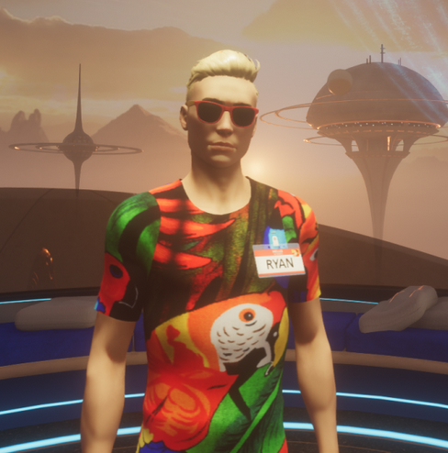
The Future
Second Life is a significant cash cow for Linden Lab, the company that makes it, and it would appear that (despite lacking the userbase of, say, Fortnite or Roblox) it will have a long, healthy life ahead of it.
Linden Lab did try to launch a social VR platform, called Sansar, which was sold off to a third party before the company itself went into private hands. Sansar, despite being one of the most beautiful social VR platforms, has struggled to find an audience, both under Linden Lab and in third-party hands, although it does still have a small but committed userbase.

Slide 56
Questions?
Ryan Schultz
Ryan Schultz: News and Views on Virtual Worlds, Social VR and the Metaverse (my blog): https://ryanschultz.com

