Slide 1

Artificial Intelligence and Generative AI: An Introduction
Ryan Schultz, University of Manitoba Libraries
Updated March 6th, 2026
Artificial Intelligence and Generative AI Presentation Ryan Schultz blog version @ 2026 by Ryan Schultz is licensed under CC-BY-NC-SA 4.0. To view a copy of this license, please visit: https://creativecommons.org/licenses/by-nc-sa/4.0/
Notes:
Hello, my name is Ryan Schultz, and I will be talking to you today about artificial intelligence in general, and a subset of AI called generative AI in particular.

Slide 2

Traditional Territories Acknowledgment
The University of Manitoba campuses and research spaces are located on original lands of Anishinaabeg, Ininiwak, Anisininewuk, Dakota Oyate, Dene and Inuit, and on the National Homeland of the Red River Métis.
UM recognizes that the Treaties signed on these lands are a lifelong, enduring relationship, and we are dedicated to upholding their spirit and intent. We acknowledge the harms and mistakes of the past and the present. With this understanding, we commit to supporting Indigenous excellence through active Reconciliation, meaningful change, and the creation of an environment where everyone can thrive. Our collaboration with Indigenous communities is grounded in respect and reciprocity and this guides how we move forward as an institution.

Slide 3
What is artificial intelligence/AI?
AI is an umbrella term which refers to computer programs that can mimic human tasks like learning, reasoning, and problem-solving.
These systems are not “intelligent” in a human sense. While AI has advanced rapidly, it still lacks human-like common sense and reasoning.
AI is not sentient; it lacks awareness and cannot perceive emotions. There is a tendency to anthropomorphize generative AI tools like ChatGPT, but there is no person on the other side.
Notes:
AI is an umbrella term which refers to computer programs that can mimic human tasks. These systems are not 'intelligent' in a human sense. While AI has advanced rapidly, it still lacks common sense and human-like reasoning. AI is not sentient; it lacks awareness and cannot perceive or understand human thoughts or emotions.

Slide 4

Three Types of AI by Capability
Artificial Narrow Intelligence (ANI)
Excels at one specific task. All current AI is Narrow AI.
Examples: Siri, Netflix recommendations, Tesla’s self-driving software.
Artificial General Intelligence (AGI)
A theoretical AI with human-level cognitive abilities. Still science fiction.
Artificial Superintelligence (ASI)
A hypothetical AI that surpasses human intelligence. Largely speculative. appearing often in philosophical and theoretical discussions about AI’s future, and of course in science fiction books and movies (e.g. the Terminator series)
Notes:
We can categorize AI by its capabilities. All AI systems that exist today are considered Narrow AI, which means they excel at a specific, limited task. The second type, General AI or AGI, is a theoretical form of AI with human-level intelligence across any domain; this is still the stuff of science fiction. The final type is Superintelligent AI, a hypothetical future AI that would surpass human intelligence. This remains largely speculative.

Slide 5
AI Types by Computational Approach
Symbolic AI
Programmers hand-code logical rules and facts.
Solves problems using logical reasoning.
Example: IBM’s Deep Blue chess computer
Machine Learning (ML)
Algorithms are trained with data to discover and learn from examples.
Makes predictions or decisions without being explicitly programmed.
Example: Gmail’s spam detection system.
Deep Learning
A subset of ML using multiple layers of “neural networks” to learn complex patterns from vast amounts of data.
Generative AI is a subset of Deep Learning.
Example: ChatGPT.
Notes:
We can also look at AI by its computational approach. The earliest form is Symbolic AI, or 'Good old-fashioned AI,' where programmers hand-code logical rules and facts to solve problems. A famous example is IBM's Deep Blue, the chess computer that beat the world champion in 1997. A more modern approach is Machine Learning, where algorithms are trained on lots of data to learn from examples and make predictions without being explicitly programmed. Gmail’s spam filter is a perfect example of this. Finally, we have Deep Learning, which uses multiple layers of interconnected artificial neurons to automatically learn very complex patterns from vast amounts of data. Most modern systems, including Generative AI, are a subset of deep learning.

Slide 6

Generative AI: What is it?

Slide 7
What is Generative AI (GenAI)?
A newer subset of AI that creates new content like text, code, pictures, and music.
Example:
A spam filter classifies email (this is not GenAI).
ChatGPT writes a new email for you from scratch (this is GenAI).
Notes:
So where does Generative AI fit in? GenAI is a newer subset of AI systems designed to create new, original content. They do this by learning the patterns and structure from enormous datasets and then using that knowledge to generate new outputs that resemble the data they were trained on. A good way to think about the difference is with email. Your Gmail spam filter is a form of AI, but it's not generative because it only classifies incoming emails as spam or not spam. On the other hand, you could ask a generative tool like ChatGPT to write a brand new email for you from scratch, and it would do an excellent job!

Slide 8
Three Things that Made the GenAI Boom Possible
New algorithms: in particular, transformer architecture (2017) which revolutionized the processing of long text passages
Data explosion: an explosion of digital data which provided the raw material to train GenAI systems (sometimes without permission!)
Computing power: massive increases in computational power made it possible to train GenAI on this vast amount of input data

Slide 9
How GenAI Works
Pre-training: models analyze billions of text examples, learning to predict what comes next
Fine-tuning: models are refined to follow instructions, be helpful, and to avoid harmful content (this work is mostly done by humans)
Deployment: users provide prompts, and the model generates responses based on the prompts and patterns it learned during training

Slide 10
The GenAI Boom of 2022
The current hype about AI was sparked by startling leaps forward in two key areas:
Text-to-image AI programs (DALL-E 2, Midjourney, Stable Diffusion).
AI Large Language Model (LLM) text-generation tools like ChatGPT 3.5.
ChatGPT gained 100 million users in two months, breaking all previous records for the adoption of new technology.
Notes:
The current hype about AI was sparked in 2022 by startling leaps forward in two key areas of Generative AI. First were the text-to-image programs like DALL-E 2 and Midjourney that amazed everyone. This was followed by the launch of ChatGPT 3.5 in November 2022. The service was so popular that it gained 100 million users in just two months, breaking all historical records for the adoption of new technology.

Slide 11
GenAI in Higher Education: Strengths
Brainstorming & Idea Generation: Quickly creates quizzes, lesson plan ideas, or examples to spark creativity.
Personalized Learning: Acts as a tireless tutor, providing instant answers and feedback tailored to student needs.
Enhanced Student Engagement: Lets students test ideas, explore scenarios, or even role-play with historical figures!
Efficiency: Offloads more routine work, freeing up faculty & instructors for one-on-one mentoring and research.
Notes:
In higher education, Generative AI presents significant opportunities. It’s a powerful tool for creativity, helping instructors brainstorm lesson plans and generate examples. It can provide personalized learning by acting as a tireless tutor, giving students instant, tailored feedback. It can also enhance engagement by allowing students to explore 'what if' scenarios or even have a discussion with an AI role-playing as a historical figure. By offloading more mundane tasks, it frees up faculty to have more time for one-on-one mentoring and research.

Slide 12
GenAI in Higher Education: Weaknesses
Accuracy: Can produce incorrect or fabricated information while sounding confident, so everything must be verified against authoritative sources.
Bias: Can reproduce human biases from its training data, underrepresenting marginalized perspectives.
Academic Integrity: Raises concerns about plagiarism, cheating, and the need to rethink student assessments.
Learning impact and over-reliance: Raises concerns about the use of GenAI undermining critical thinking and problem-solving skills.
Privacy & Security: Raises questions about how user data is stored, used, and who owns the output.
GIGO (Garbage In, Garbage Out): Raises concerns about the sources and quality of data used to train GenAI tools. Poor data = poor results.
Notes:
However, we must be aware of the weaknesses. These tools can still produce incorrect or fabricated information while sounding very confident, which means everything needs to be double-checked and verified. They are trained on data that contains human biases, which they may then reproduce. GenAI also poses new questions for academic integrity and how we assess student work ethically. There are also concerns about the longer-term impact of GenAI on student’s ability to develop critical thinking and problem-solving skills. Finally, we must consider privacy and security: how is the information you enter being used and stored, and who owns the content the AI produces? The last point, called GIGO (Garbage In Garbage Out) is one I noticed when having a conversation with GenAI tools about a topic which I am an expert on, which is virtual worlds, social VR and the metaverse (this is a technique I will talk about later). Some of the sources used in the reports I generated using the Deep Research feature (which provides citations to webpages which I then checked), indicate the well-known computer science concept of GIGO: Garbage IN Garbage Out. In some cases, where good-quality data is hidden behind paywalls, these tools rely on questionable data from free websites instead.

Slide 13
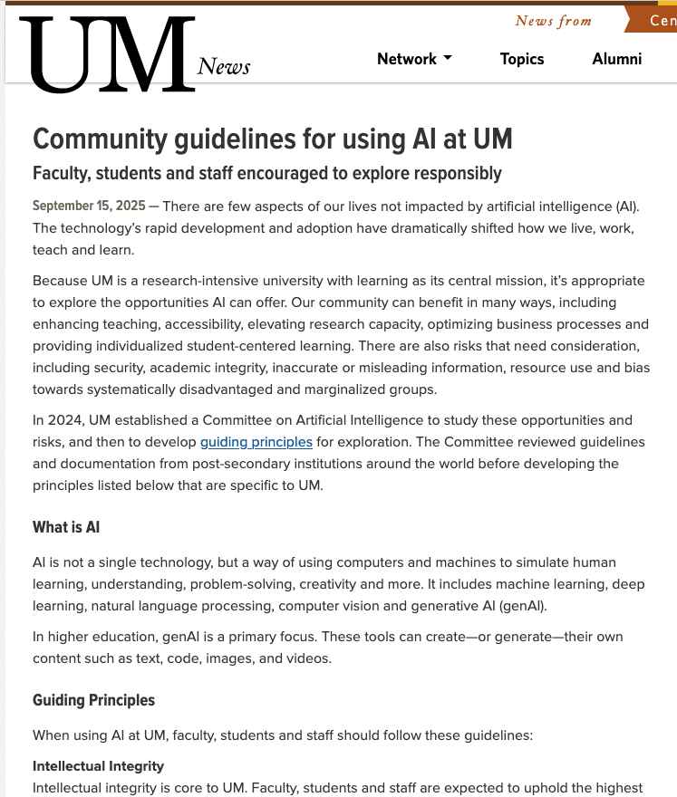
UM has issued new community guidelines for using AI and GenAI
The UM Committee on Artificial Intelligence has issued a Guiding Principles document which was endorsed by Senate on June 25th, 2025, and updated Oct. 1st, 2025: https://umanitoba.ca/governance/sites/governance/files/2025-06/ai-guiding-principles-2025-06-25_0.pdf
These nine Guiding Principles are:
Intellectual Integrity | IP & Copyright
Human-Centered Approach | Environment & Sustainability
Responsible Behaviour | Accessibility & Fairness
Ai Literacy & Training | Risk & its Mitigation
Privacy & Data Security
Notes:
Because of these opportunities and risks, the University of Manitoba has established a Committee on Artificial Intelligence to study these issues. This committee has issued a Guiding Principles document, which was endorsed by the Senate on June 25th, 2025. These nine principles are intended to guide the responsible exploration and use of AI at the university. They cover key areas like Intellectual Integrity , IP & Copyright , maintaining a Human-Centered Approach , ensuring Accessibility & Fairness , and protecting Privacy & Data Security.

Slide 14
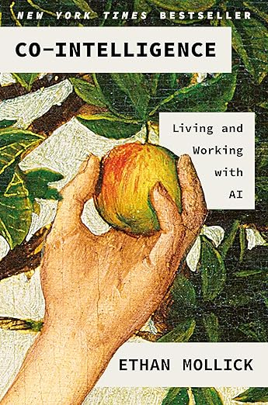
Some Recommendations to Learn More about Generative AI (GenAI)
Anthropic (the makers of the GenAI tool Claude) have published an excellent, free online course titled Introduction to AI Fluency here: https://www.anthropic.com/ai-fluency/introduction-to-ai-fluency . The goal of this 12-lesson course (which you can use with any GenAI tool, not just Claude) is to learn how to collaborate with GenAI systems effectively, efficiently, ethically, and safely.
A good popular book to read about GenAI is Ethan Mollick’s 2024 book titled Co-Intelligence: Living and Working with AI (this book is available in the UM Libraries collection, in both print and electronic versions, but the online version can only be read onscreen, not downloaded).
Notes:
If you want to learn more, there are some excellent resources available. The company Anthropic has published a free online course called Introduction to AI Fluency. It’s a 12-lesson course that teaches you how to work with these systems effectively, efficiently, and ethically. A great book on the topic is Ethan Mollick’s 2024 book, 'Co-Intelligence: Living and Working with AI'. It includes many practical tips and is available right here in the UM Libraries collection.

Slide 15
Concepts from Anthropic’s AI Fluency Course: The 4 Ds
Four core competencies of AI fluency:
Delegation: deciding what work should be done by humans, what work should be done by AI, and how to distribute tasks between them.
Description: effectively communicating with AI tools, including clearly defining outputs, guiding AI processes, and specifying desired AI behaviours and interactions.
Discernment: thoughtfully and critically evaluating AI outputs, processes, behaviours, and interactions (assessing quality, accuracy, appropriateness, and areas for improvement).
Diligence: using AI responsibly and ethically (maintaining transparency and taking accountability for AI-assisted work).
Notes:
The Anthropic course outlines four core competencies for AI fluency, which they call the 4 Ds. Delegation is about deciding what work humans should do and what work AI should do. Description involves effectively communicating with the AI to guide its processes. Discernment is the critical evaluation of AI outputs for quality and accuracy. And Diligence means using AI responsibly and ethically, and taking accountability for the work it helps you produce.

Slide 16
Ethan Mollick’s Four Rules for Using GenAI
Principle 1: Always invite GenAI to the table. You should try inviting AI to help you in everything you do, barring any legal or ethical issues, to learn its capabilities and failures.
Principle 2: Be the human in the loop. GenAI works best with human help; always double-check its work.
Principle 3: Treat GenAI like a person (but tell it what kind of person it is). Give it a specific persona, context, and constraints for better results. For example, you’ll get better results from the detailed prompt “Act as a witty comedian and generate some slogans for my product that will make people laugh” instead of the more generic prompt “Generate some slogans for my product.”
Principle 4: Assume that this is the worst GenAI tool you will ever use. Generative AI tools are advancing and evolving rapidly.
Notes:
In his book, Ethan Mollick proposes four key rules for working with AI. First, always invite AI to the table—try using it for everything you do to quickly learn its capabilities and failures. Second, always be the human in the loop. GenAI works best with human help, and you must resist the temptation to delegate everything and always verify the information it gives you. Third, treat it like a person by giving it a clear persona, context, and constraints for the task. And finally, assume this is the worst AI you will ever use, because the technology is advancing at an incredible pace.

Slide 17
Three GenAI Tools Recommended by Ethan Mollick
ChatGPT by OpenAI/Microsoft chatgpt.com | Claude by Anthropic claude.ai | Gemini by Google gemini.google.com
Limited free use US$20/month Plus plan | Limited free use US$17/month Pro plan | Limited free use US$20/month Pro plan
GPT 5.3 Instant: quick answers GPT 5.2 Thinking Auto: chats GPT 5.2 Thinking with Extended Thinking: good for work (requires Plus level) | Claude Haiku 4.5: quick answers Claude Sonnet 4.6: good for chats Claude Opus 4.6 Extended Thinking: good for work and hard problems (requires Pro level) | Gemini 3 Fast: chats & answers Gemini 3 Thinking: good for work (requires Pro level; turn on Deep Research from the Tools menu) Gemini 3 Pro: math & code
ChatGPT does use your data in training (but you can turn it off, without loss of functionality). | Privacy focused: Claude does not train future AI models on your data. Seems to be more focus on ethics? | Gemini does use your data in training (you can turn it off, but you will lose some functionality).
Deep Research option for more accurate, in-depth research | Research and Web Search options for more in-depth research | Deep Research option for more accurate, in-depth research
Good at image creation; Study & Learn mode; Shopping Research | Weaker at image & video generation than ChatGPT and Gemini | Best at images (nano banana); Best at video creation (Veo 3.1)
Source: Mollick, E. A Guide to Which AI to Use in the Agentic Era. One Useful Thing newsletter, Feb. 17th, 2026.
Notes:
This is a summary of the three general-purpose generative Ai tools recommended by Ethan Mollick in his One Useful Thing newsletter (which I subscribe to on Substack). I currently have paid accounts for ChatGPT, Claude, and Gemini at the US$20-a-month level, and I have learned a lot about how these GenAI tools work by entering the exact same initial text prompt into each one, then comparing results between these three tools. In addition to free and $20-a-month plans, all three tools also offer a more expensive plan for heavy use: Claude Max at $100 per month, ChatGPT Pro at $200 per month, and Google AI Ultra at $250 per month (with the first 3 months at a 50% discount). Most users will only need the $17/20 a month plan.

Slide 18
New for 2026: AI Agent Tools
In the newest Feb. 17th, 2026 edition of Ethan Mollick’s AI Guide (https://www.oneusefulthing.org/p/a-guide-to-which-ai-to-use-in-the), he discusses the shift from chatbots (where you have a conversation with the tool) to agents (where you give a specific, defined task with instructions to the tool, and it goes away and does the task and returns with results).
For example, Claude Code, OpenAI Codex, and Google Antigravity are all agents aimed at computer programmers. You describe what you want built, and the AI agent goes and builds working code for you. (I have not tried out these tools myself.)
Claude for Excel and PowerPoint are specific agents/harnesses inside Microsoft applications. For example, you can tell these AI agents what you want to do with an Excel spreadsheet, and it will try and execute it. (Again, I have not tried out these tools myself.)
In my limited personal experience with agents to date (Claude Cowork), I found that simply handing something off to an agent, as opposed to the back-and-forth conversation with a chatbot interface, does not always give the best result.

Slide 19
However, there are many GenAI tools besides those three general-purpose choices:
Runway, Kling (and other tools): for AI video editing, creative workflows, and text-to-video creation
Midjourney, Stable Diffusion, Adobe Firefly, Flux, Ideogram, NightCafe: image generators
AIVA, Amper AI, Jukebox, Soundraw, Evoke: music generators
Replica, Speechify, Murf, Play.ht, Lovo.ai, Eleven Labs, HeyGen: text-to-speech conversion, AI-generated voices/voiceover, even AI-generated spokespeople/talking heads!
Elicit, Undermind, Consensus, Assistant by Scite: AI-powered research assistants which discovers and summarizes academic sources (e.g. methods, results, conclusions). These tools are useful for literature reviews, research scoping, and discovering research trends.
Google NotebookLM is used to make sense of a lot of information (you download and run the tool on your own computer; training it on your personal research library by uploading PDFs, other files, websites, YouTube videos, audio files, Google Docs, Google Slides, etc.)

Slide 20
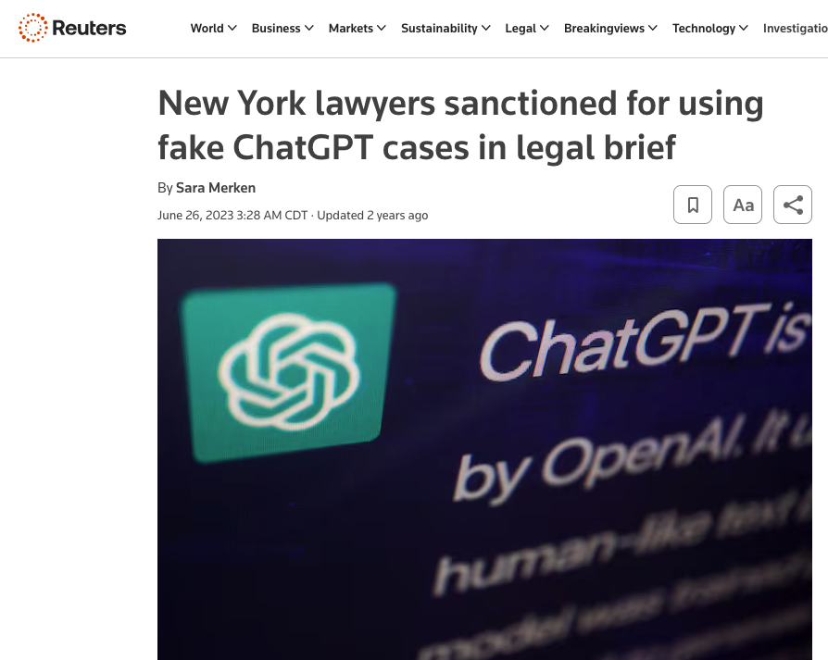
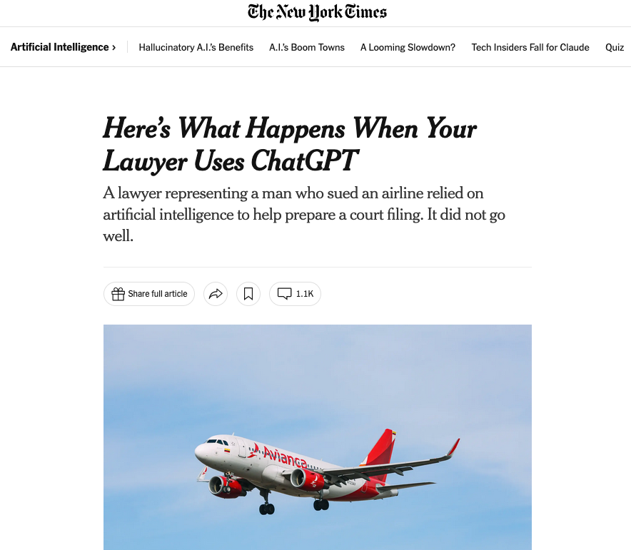
GenAI “Hallucinations”: Steven Schwartz, the Avianca Lawsuit, and ChatGPT
GenAI tools can “hallucinate” by creating Frankenstein-like responses from bits of training data. They might invent non-existent books or articles.
You must double-check and verify any information provided by GenAI against authoritative sources.
Case Study: lawyers sanctioned for using fake ChatGPT-generated legal cases in a lawsuit.
Notes:
A major issue with these tools is their tendency to 'hallucinate' responses, essentially creating a Frankenstein-monster-like response by throwing together bits and pieces of data from its training dataset. They might refer to a book or research paper that simply doesn’t exist! For this reason, it is imperative to double-check and verify any information they provide against authoritative sources. A famous example of this is the Avianca lawsuit, where two lawyers in New York were sanctioned by a judge for submitting a legal brief that cited several non-existent court cases invented by ChatGPT.

Slide 21
Tips for Best Results When Using GenAI
Have a conversation: Don’t treat GenAI like a vending machine; engage in a back-and-forth conversation to refine the output.
Give it context: Upload documents or images; provide examples of what “good” looks like to help it understand the pattern or style you want in the output.
Be clear about what you want: Provide details, step-by-step instructions, and specific rules to follow.
Ask for help: If you’re unsure, ask the GenAI tool to ask you questions to help clarify your goal. You can even ask it for help creating prompts!
Notes:
To get the best results, it's helpful to follow a few practices. First, have a conversation with the tool. Engage with it in a back-and-forth dialogue to refine the output. Second, give it context and examples. You can upload documents or provide examples of the style or format you're looking for. Third, be clear and specific in your instructions. And if you're not sure what you want, you can even ask the AI to ask you clarifying questions to help you formulate a better prompt.

Slide 22
Caveats to Keep in Mind When Using GenAI
GenAI can be confidently wrong! Always double-check any information you get from a GenAI tool against authoritative sources (use the UM Libraries!)
GenAI tends to reinforce biases from the data it was trained on. The companies building these GenAI tools try to correct them to address sexism, racism, homophobia, transphobia, etc., but sometimes these biases can still appear in the responses.
Never enter confidential information. It may become part of its dataset.
Notes:
There are several important caveats. First and most importantly, GenAI can be confidently wrong, so you must always double-check any information it provides. These tools also tend to reinforce existing biases from their training data. They are also still terrible at math, so don't rely on them for calculations. Finally, never enter confidential or sensitive information into a public GenAI tool, as that content may become part of the training data and could resurface in other people's prompts.

Slide 23
The Best Way to Learn is to Use Them!
Pick a topic you are an expert in. Engage the AI in a conversation. It will be easier for you to spot incorrect or “hallucinated” response.
Pick a topic you know nothing about. Ask the AI to explain it to you at various levels (e.g. for a six-year-old, for a university student, etc.)
Be creative in your prompting. Tell it what role to take (e.g. comedian) and what output you want (e.g. funny slogans for chewing gum).
Remember: These tools are not sentient; they generate human-like replies based on training, so be aware of the tendency to anthropomorphize them.
Notes:
Ultimately, the best way to learn these tools and their limitations is simply to use them. I'd suggest two exercises. First, pick a topic you're an expert in and have a conversation with the AI. Because you're the expert, you'll easily be able to spot its mistakes and hallucinations. Then, do the opposite: pick a topic you know nothing about and ask the AI to explain it to you at different levels of complexity. You could ask it to explain a topic in a million different ways, and it never gets tired or bored! Finally, be creative. Experiment with telling the AI to take on a specific role or persona; you'll find the results are much more interesting.

Slide 24
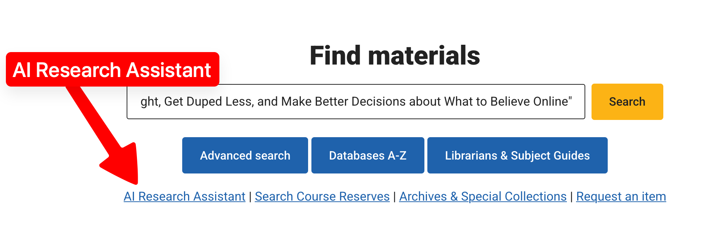
NEW as of Sept. 2025: The UM Libraries AI Research Assistant

Slide 25
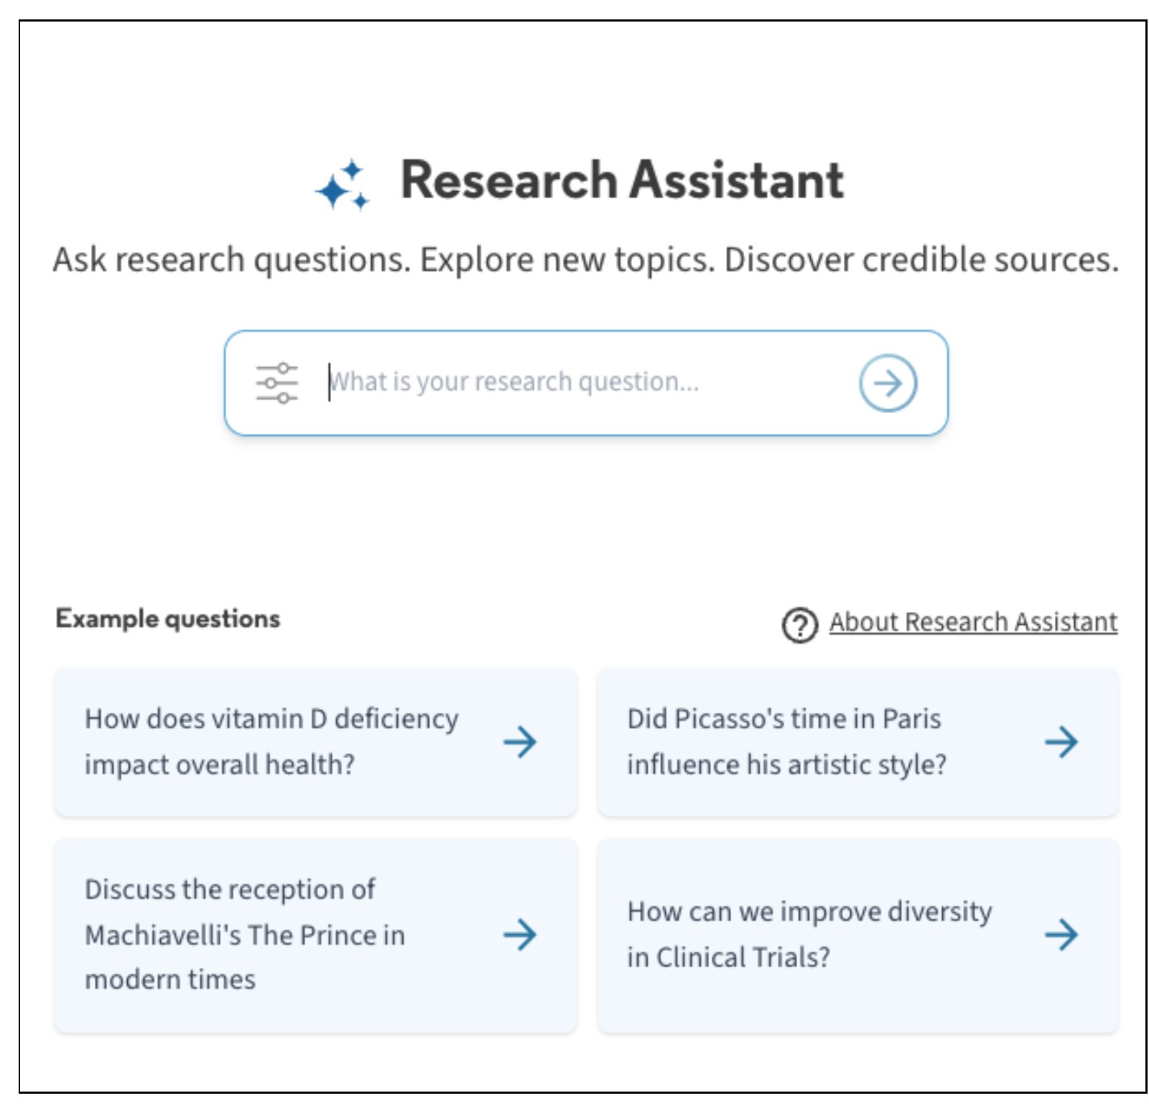
The UM Libraries AI Research Assistant
Can respond to questions posed in natural language.
Generates a summary drawn from five (and only five) academic sources from the Libraries' collection.
Provides a link to a complete set of search results.
Allows you to ask follow-up questions.
Severe limitations: it cannot retrieve from print sources, certain electronic full-text databases (JSTOR, Elsevier, news media); it does not search the web.

Slide 26
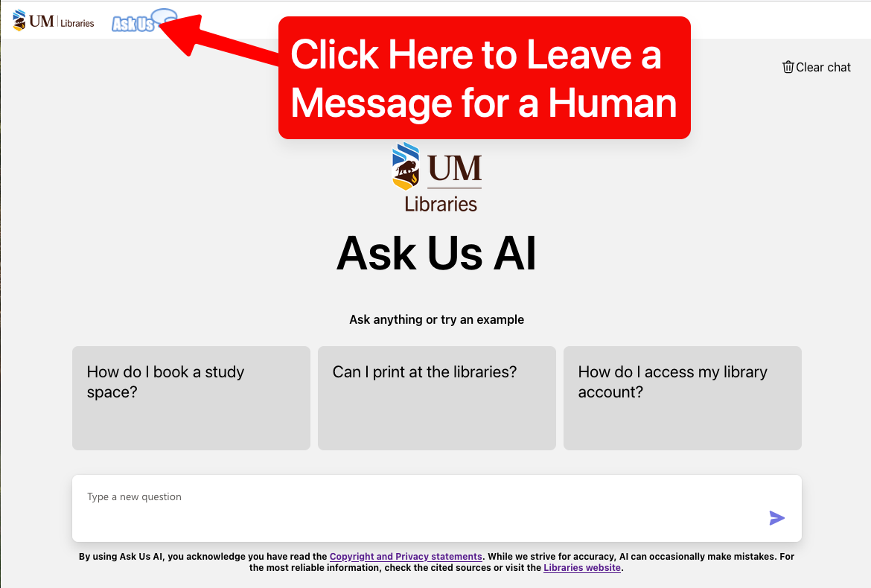
After Human Staffing Hours: Ask Us AI Chatbot
Ask Us is a live text chat with a Libraries staff member, hours are:
Mondays through Thursdays: 9am-8pm
Fridays: 9am-6pm
Saturdays: 10am-6pm
Outside of these hours and on Sundays, you are automatically connected to the Ask Us AI Chatbot, which is trained on a subset of Libraries documents.
Click on the Blue Ask Us logo in the upper right to leave a message for a human!

Slide 27
Tips for Staying on Top of AI
Subscribe to email newsletters and follow AI experts on social media.
Watch YouTube videos and listen to podcasts on AI topics.
Read books for broader concepts, but keep in mind that Generative AI only became popular since 2022, and the field is evolving rapidly, so be sure to find up-to-date information sources.
Start an informal discussion group to share ideas.
Use GenAI tools to summarize articles and research papers (upload a PDF directly and ask it to write a summary). This is a real time-saver, and it will help you decide which articles or papers to read in depth.
Source: Hennig, Nicole. 10 Tips for Keeping Up with Generative AI. https://nicolehennig.com/wp-content/uploads/2025/06/10-tips-genAI-hennig2025.pdf
Notes:
The field of AI is changing incredibly fast. To stay on top of it, I recommend subscribing to email newsletters and following AI experts on social media. YouTube and podcasts are also great resources for current discussions. While books are good for historical context, remember to seek out up-to-date information for this rapidly changing field. You could also start an informal discussion group with colleagues to share what you're learning. For examples, the University of Manitoba librarians have a Generative AI Community of Practice. One of the best time-saving tips is to use GenAI tools themselves to summarize long articles and research papers, which helps you decide what to read in depth.

Slide 28

The key is learning how to use these GenAI tools (because they are not going away, and they will probably impact your work and your life) — and learning their strengths and weaknesses. Thank you! Ryan Schultz
Notes:
As part of the Diligence core competency I mentioned earlier, in the Anthropic AI Fluency course, I will be transparent about how I used generative AI tools in creating this PowerPoint presentation. In addition to conducting my own research, I used both ChatGPT and Claude to do additional research into this topic, some of which made it into this presentation. I had a lot of text-heavy slides in the first draft of my presentation, so I asked Google Gemini to provide suggestions on how to reformat my slide presentation to have fewer bullet points per slide. I also did try to ask ChatGPT and Gemini to redesign the theme and design aspects of my PowerPoint slides, but I was very unsatisfied with the results, despite several attempts, and I finally gave up on using AI for that task. This is the end of my slide presentation. Thank you!

