Slide 1
Your Metaverse Is Too Small
How the Biases and Preconceptions of Virtual Worlds Hinder Their Use in Education
Ryan Schultz, University of Manitoba Librarian and Blogger at RyanSchultz.com
2026 Virtual Worlds Best Practices in Education Conference, March 20th, 2026
Notes:
Hello, my name is Ryan Schultz. In my day job, I am a librarian for the Science and Technology Library at the University of Manitoba. But in my off hours, I am also a blogger who has been writing about the metaverse for eight years now. I have been in Second Life, in one avatar or another, for almost 19 years now. I like to joke that I got my Ph.D. in Virtual Worlds from the University of Second Life!
My talk is titled “Your Metaverse Is Too Small: How the Biases and Preconceptions of Virtual Worlds Hinder Their Use in Education.” I have 45 minutes to get through 30 slides, so I am going to move FAST. However, I will assume that my presentation will be recorded (as they usually are), and I will probably also share a copy of my slides and notes via my blog, at RyanSchultz.com, sometime after I give this talk. So, let’s get started!

Slide 2
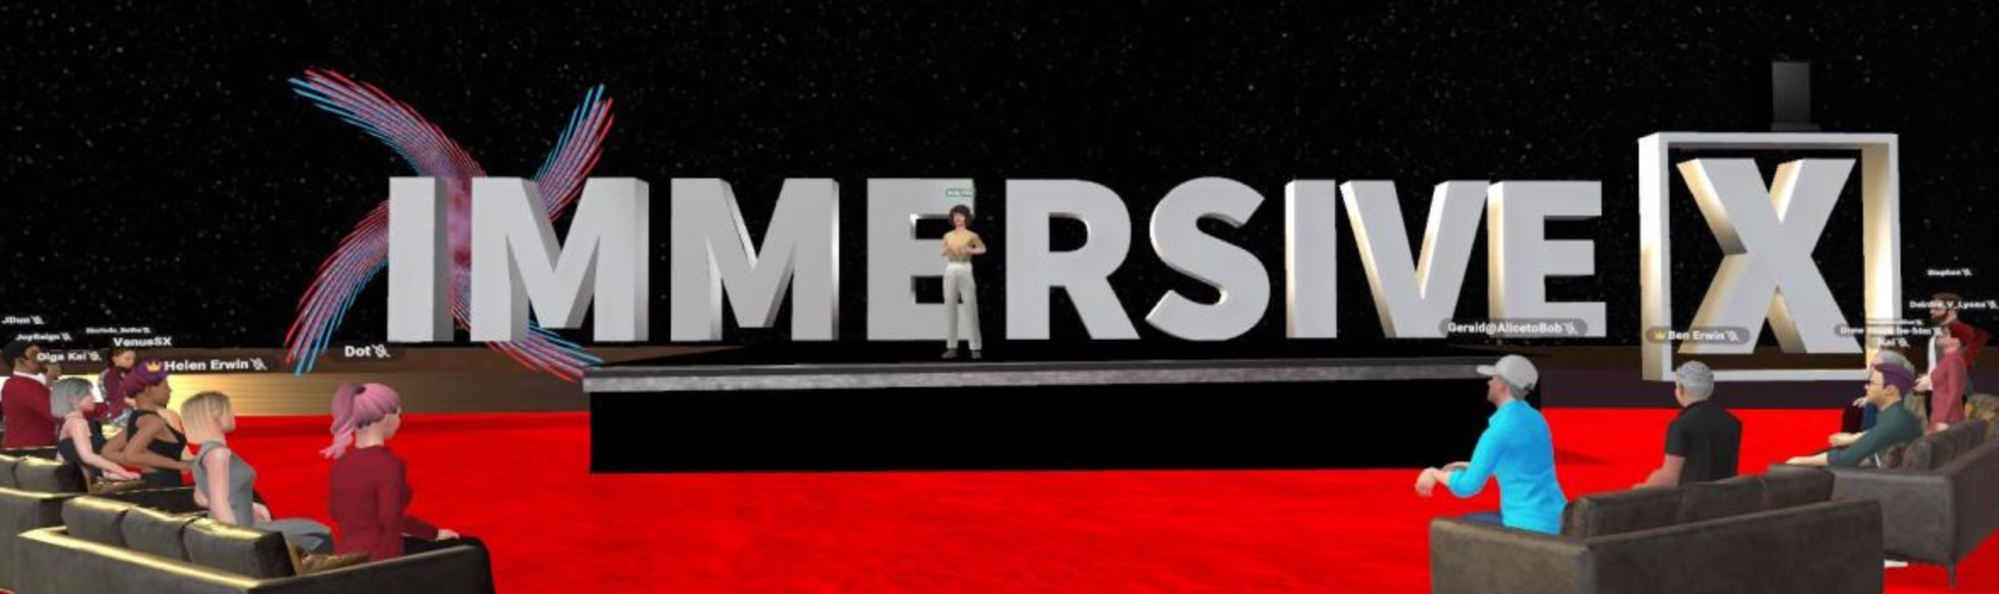
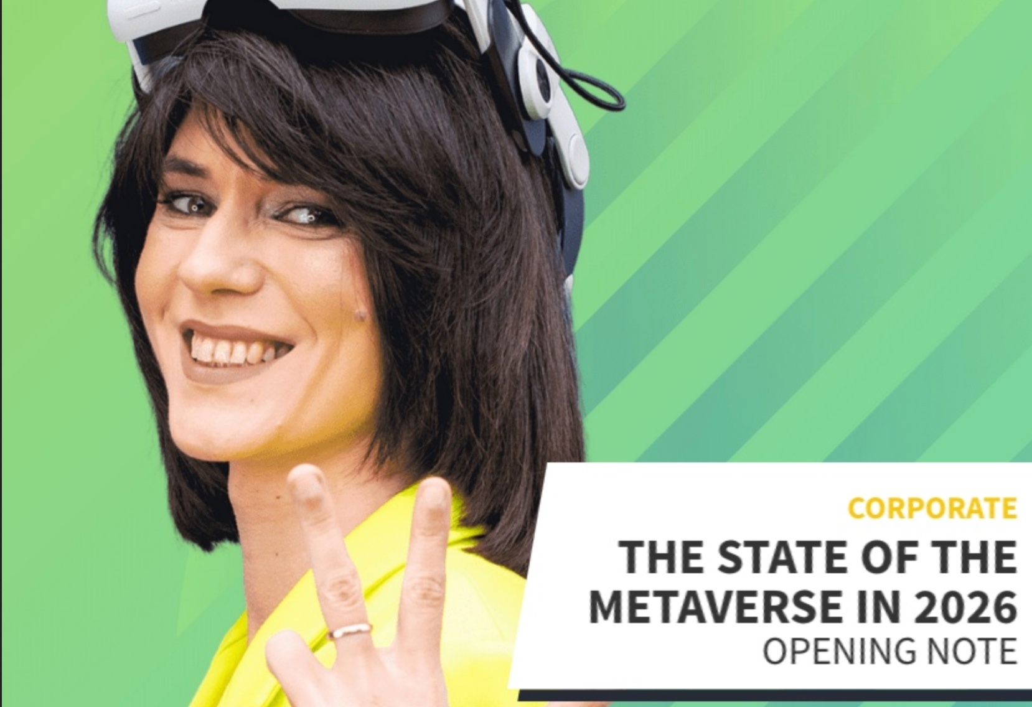
My Inspiration: Andy Fidel
Top image: RyanSchultz.com
Bottom image: https://immersive-x.de/sessions/the-state-of-the-metaverse-in-2026
State of the Metaverse in 2026 (Opening Keynote to the IMMERSIVE X Conference, Nov. 11th, 2025, in ENGAGE XR)
The next 7 slides are only the highlights from her speech, based on the notes she kindly shared with me.
Notes:
The inspiration for my talk today came from another keynote presentation I attended last November, which was given by the well known metaverse evangelist Andy Fidel.
Andy Fidel, the founder and creative lead at Spatial Networks, delivered the keynote address titled "The State of the Metaverse in 2026" on the ENGAGE social VR platform during the IMMERSIVE X conference on November 11th, 2025. Her presentation was kept off YouTube at her own request, though she shared her personal speech notes with me, from which I posted some excerpts on my blog.
So, the next seven slides are quotes which I particularly enjoyed from Andy’s talk, which I also wanted to share with you. I will be referring to Andy’s comments often throughout the rest of my presentation.

Slide 3
1. Andy Fidel on the Rise of Niche Communities in the Metaverse
“The real shift [is]…moving away from massive platforms and into micro-communities. Niche is becoming mainstream.”
“I’m seeing all these new platforms emerge…and the tools? They’re getting so good and so accessible! That soon, anyone will be able to build their own platform. Their own space. Their own world.”
Notes:
Andy Fidel explains that the metaverse is shifting away from massive, centralized platforms toward niche communities. Rather than one single Metaverse, Andy imagines a future with a "constellation of worlds" or a Multiverse that merges physical, digital, and immersive spaces. She also talked a bit about how the creation tools are becoming better, which means everyone will soon be able to build their own virtual worlds, create their own niche.

Slide 4
2. Andy Fidel on Measuring Success
“We’ve got to find new ways of measuring success when it comes to connection. Every social metric measures visibility: impressions, clicks, followers. That’s activity, not authenticity…
I’m done chasing mass engagement and empty distribution.
Because connection isn’t content. It’s presence.”
Notes:
(read text on slide)

Slide 5
3. Andy Fidel on Community
“The future of connection isn’t centralized. It’s community-coded. Our gathering places are getting smaller, weirder, and more human.
This Metaverse concept? It’s not pulling us apart. It’s inviting us to go deeper.
We’re not scrolling past each other anymore—we’re showing up for one another.”
Notes:
Gathering spaces are becoming smaller, "weirder," and more human, with identity and culture at their core. (read rest of slide)

Slide 6
4. Andy Fidel: Co-Creation and Presence
“In the Metaverse, we don’t just consume. We co-create. The audience is the algorithm.”
“I remember back in AltspaceVR, we didn’t go looking for the featured world. We looked for a world that had someone in it. Because presence mattered more than promotion…Because the most powerful story in your world is the one your audience creates inside it.”
Notes:
Andy stated that in the metaverse, the audience "is the algorithm," and community-generated content is the content. Instead of just passive watching a story, community members step into and shape it, co-create it together. For those who build these spaces, the role has shifted from broadcasting to "hosting" and "co-building community". (read AltspaceVR quote from slide)

Slide 7
5. Andy Fidel on Finding Meaning
“The Metaverse isn’t here to replace the real world. It’s here to layer it with new forms of meaning…
And look—if you say, “the Metaverse isn’t for me,” that’s a bit like saying “the internet wasn’t for me” in the ‘90s.
You don’t have to love every corner of it. You just have to find the part that resonates.”
Notes:
(read text on slide) The goal of a community should be resonance—finding a "tribe" through shared language and culture—rather than simply "going wide" or going viral.

Slide 8
6. Andy Fidel: Presence in the Age of Artificial Intelligence
“AI is generating more content than we can possibly consume—but with all that noise, connection gets diluted. What cuts through? Real people. Real time. Real attention.”
“As AI floods our feeds, the most valuable thing we still have to give is our actual presence: our time, our energy, our attention.”
Notes:
(read text on slide)

Slide 9
7. Andy Fidel on Metaverse Design
“If anything, I urge everyone in our industry to build our digital spaces the way we design cities: with flow, gathering spots, heart and soul. Places that invite people to linger, not just scroll. It’s not just about what people see—it’s about where they feel seen.”
“The Metaverse isn’t about making more content. It’s about making spaces that matter…spaces that people want to show up for. Create space, not noise.”
Notes:
Finally, she issued a call to action for developers and creators to approach virtual world-building with the same care used in urban planning. (read text on slide)

Slide 10
My Reactions to Andy’s Keynote Speech
After hearing Andy’s keynote speech, I realized that our notion of what the metaverse is, is still too small or too limited. (Hence the title of this presentation.)
Our biases and preconceptions of what the Metaverse is, can hinder the use of virtual worlds in education.
Notes:
Well, that speech by Andy really made me think. Andy’s presentation made me realize that most of us (including me) are still carrying around a lot of preconceptions, misconceptions, and biases when we build, use, and talk about metaverse platforms. And those biases and preconceptions cause us problems when we try to use the metaverse for educational purposes.

Slide 11

Some Initial Observations about the Metaverse
Image credit: Image by Riki32 from Pixabay.com
Notes:
The rest of my presentation consists of some initial observations about the metaverse (my own thoughts, in four slides), and then the final section where I specifically talk about the many ways “your metaverse is too small.”

Slide 12

The Current Metaverse Winter
I have coined the term “metaverse winter” to describe a period of cooling interest and industry contraction that follows a metaverse hype cycle. People become disillusioned when products fail to meet expectations.
We can expect more retrenchment and platform shutdowns during this metaverse winter.
(image: Photo by Else-Marie de Leeuw on Unsplash.com)
Notes:
I describe the concept of a "metaverse winter" as a period of cooling interest and industry contraction that follows a massive hype cycle. It’s a period where the initial technological promises fail to meet expectations, leading to what the Gartner consulting group politely calls the "trough of disillusionment.“ I've noted that the surge in interest sparked by Facebook’s rebranding to Meta in October 2021 was short-lived. By early 2023, I observed a significant decline in visitors to my blog and a drop in public interest. I point to recent metaverse platform shutdowns, such as the shutdown of platforms like Meta’s Horizon Workrooms in February 2026, as evidence of the metaverse winter setting in. And I predict that only those metaverse platforms which offer compelling use cases and genuine human connection will survive to see the next boom cycle.

Slide 13
A Note About Interoperability
Ready Player Me showed the pitfalls of relying on a shared but closed standard; open standards are needed for true interoperability, but we are not there yet.
Given the current walled-garden state of virtual worlds, and virtual reality, this is probably an impossible goal.
Notes:
A major theme in my blog is the risk of building the metaverse on proprietary infrastructure rather than open standards. When Netflix acquired Ready Player Me recently and announced the shutdown of its avatar creation services, thousands of developers who relied on it as a foundational layer had to scramble to replace their avatar identity systems. This example shows that "interoperable but closed ≠ open.“ Ideally, the future Metaverse should rely on open world compatibility and open standards, rather than walled gardens. However, using existing game engines as a base (e.g. Unity, Unreal) is a very common time-saving measure among metaverse-building companies. Will we ever get to a truly interoperable universe of metaverse platforms? Who knows.

Slide 14
Good answers to the question: why do I want to do this in a virtual world/VR?
Some possible good answers to these question include:
  I want to reach a widely dispersed audience
  I want to show students somewhere where high tourist traffic would cause problems, e.g. an Egyptian tomb, or a fragile coral reef
  I want students to be creative in new ways, e.g. drawing or painting in 3D, or designing and then walking through a building
  I want to give my audience a perspective that would be difficult or impossible in real life e.g. examining the inside of a molecule, looking at supergalactic structures in 3D, or experiencing the point of view of a homeless person in immersive storytelling
Notes:
“Build it and they will come” is not a sufficient reason for a platform to exist. Too many developers build metaverse platforms without really stopping and asking themselves: why do I want to do this? This is the first of two slides where I give some examples of situations where it makes sense to use a metaverse platform. (read text on slide)

Slide 15
Good answers to the question: why do I want to do this in a virtual world/VR?
Some possible good answers to these question include:
  I want to create a space where people with physical disabilities or chronic illnesses (often homebound or hospital-bound) can connect with each other. For them, the metaverse isn't a toy; it is their primary way of gathering and maintaining a social life (e.g. Foretell Reality at Sick Kids Hospital in Toronto for teenagers battling health-threatening conditions like cancer)
  I want to provide risk-free training in hazardous environments (e.g. industrial or medical training simulations)
  I want to visit a place from the past to experience what it was like to live at that time and place (e.g. Ancient Rome; a 1920s jazz club; Anne Frank’s family in hiding during World War II)
Notes:
(read text on slide)

Slide 16
Your Metaverse Is Too Small Because…
Image credit: Image by Riki32 from Pixabay.com
Notes:
Now we come to the part of my presentation where I specifically talk about various ways our metaverse platforms are, still, too small.

Slide 17
Your Metaverse Has Too Steep a
Learning Curve
Your metaverse is too small because you make it too difficult for new users to get started. You either give them no guidance at all, or you overwhelm them with too many options and too much detail.
Many feature-rich metaverse platforms (e.g. Second Life, Resonite) have too steep a learning curve. Only a small percentage of users actually get through it!
Students must first focus on getting into/onto the platform before any learning can take place.
Notes:
Your metaverse is too small because it has too steep a learning curve. I’ve noted that while Second Life is a perfect model of a mature, fully-evolved virtual world, it still suffers from a learning curve that is way too complicated for new users.

Slide 18
Your Platform Has a Poor Fit-to-Purpose
Metaverse platforms need to move beyond “productivity theatre” and identify real problems which immersive technology can solve more effectively.
In the earlier days of Second Life, many libraries set up virtual libraries, but it was too much to ask potential users to spend an hour learning how to use SL, in order to ask a reference question or read an ebook.
Notes:
Your metaverse is too small because it has a poor fit-to-purpose. During the initial hype phase of Second Life, many real-world libraries set up virtual branches with great enthusiasm, but they eventually realized this approach was impractical. Once the initial novelty wore off, libraries found that their virtual services were barely being used. Most people logging into Second Life were doing so for entertainment, socializing, and other activities, not to visit or use a library. The "cost of admission was simply too high" for the average library patron. It was completely unrealistic to expect a user to download and install the client software, then spend 30 to 60 minutes learning complex navigation and teleportation controls, just to ask a simple reference question or read an ebook.

Slide 19
It Lacks Accessibility Features
Your metaverse is too small because it does not accommodate users with disabilities (e.g. the visually impaired, the Deaf, those with physical disabilities, etc.)
For example, text-to-speech software is important for those who are Deaf or hard of hearing.
Virtual worlds like Second Life and social VR platforms like VRChat allow users with disabilities to form communities:
  Virtual Ability in Second Life for people with various disabilites
  Helping Hands in VRChat for the Deaf/HoH community
Notes:
Your metaverse is too small because it lacks accessibility features and excludes learners like the Deaf/HoH community. For example, in VRChat, users with disabilities have often been forced to rely on third-party user mods to add missing accessibility features, such as speech-to-text functionality. When VRChat implemented an "Easy Anti-Cheat" system that blocked these mods, it caused a massive community backlash from users who relied on them. Despite these problems, several metaverse platforms have thriving communities of people with disabilities. For example, there is a thriving Deaf and hard-of-hearing (d/Deaf/HoH) community within VRChat that has developed its own adapted form of sign language.

Slide 20
Your Metaverse Is Poorly Designed
VR/Motion Sickness: affects women more than men
Poor platform design (e.g. low frame rates) can induce nausea
Both hardware and software developers need to take seriously the Quality Assurance issues of motion sickness, cognitive load, and user comfort to ensure that the technology is inclusive for all demographics.
Notes:
Your metaverse is too small because it is poorly designed and Quality Assurance tested, and it might make your users sick. Research suggests that VR sickness affects women more frequently and severely than men, yet because the early VR community was heavily male-dominated, these concerns were often dismissed as "early days" hardware problems rather than showstopper design flaws. Quality assurance (QA) in VR is significantly more difficult than in traditional software development. VR applications must deliver a stable frame rate above 72Hz to 90Hz to minimize the risk of nausea. Testing these environments requires a detailed evaluation of three-dimensional spatial audio, hand tracking accuracy, and mental strain, all of which add layers of complexity and cost that many early-stage platforms were unprepared to manage.

Slide 21
It Is Soulless (Designed by a Corporate Committee)
Your metaverse is too small because it was designed by committee instead of asking users what they want (e.g. Meta Horizon Worlds, Meta Horizon Workrooms)
This tends to happen when developers are tasked with building metaverse platforms without understanding the people who use and inhabit them. Sometimes, programmers are clueless about user culture and experience. Instead of adopting the perspective of the user and understanding why people want to use their platform, they only focus on whether the code works.
Notes:
Your metaverse is too small because it was designed by a corporate committee.
Meta’s social VR applications, Horizon Worlds and Horizon Workrooms, epitomize this problem. I described the platforms as being, quote, "even worse than boring—it's soulless." The platform looked and felt as though it was assembled by a "bureaucratic committee of engineers" who were simply completing a task to report back to their executive managers. In my opinion, the builders lacked any real understanding, appreciation, or love for what social VR can and should be. Ironically, the developers building the platform did not even bother to use it themselves.
In January 2026, Meta announced that it was shutting down Horizon Workrooms completely. Meta announced in Feb. 2026 it is shifting the focus of Horizon Worlds to be "almost exclusively mobile.” It is now being repositioned as a direct competitor to Roblox and Fortnite on mobile — and no longer as a VR social metaverse. Meta poured billions of dollars into making metaverse platforms which nobody wanted or used.

Slide 22
You Require a VR/AR/XR Headset
The biggest roadblock is probably that your metaverse platform requires users to get a VR headset.
We need to make the platform as open to as many people as possible, using devices they are likely to afford (or already have), e.g. desktop computers, notebooks, tablets, phones.
The VR headset market has not taken off as expected.
Platforms that bet the farm on PCVR eventually shut down or went on life support (e.g. Sansar).
Notes:
Your metaverse is too small because it requires you to use a virtual reality headset.
It is not a surprise that many of the most popular social VR platforms (e.g. Rec Room, VRChat) also allow for non-VR users to participate. The VR headset market still has not taken off. Even the best-selling Meta Quest line of wireless virtual reality headsets (which make up an estimated 70% of the global VR headset market) has sold only approximately 30 million units around the world, and many of those devices land up collecting dust after the initial novelty of the product wears off. Apple's Vision Pro, launched to enormous fanfare, does not publish sales figures, but industry reporters said that the company shipped approximately 390,000 units in 2024 and approximately 90,000 units in 2025. VR hardware remains bulky, heavy, and uncomfortable for extended wear. Nausea continues to affect a significant proportion of users. A VR headset isolates the wearer from their physical surroundings and from the facial expressions of the people around them—an anti-social device, in practice, even when its purpose is socialization via social VR.
The PC-tethered VR headset market—the high-end, high-fidelity segment that many early social VR platforms had built toward—proved especially stagnant. The dream of millions of consumers owning gaming-grade PCs with tethered Oculus Rift or HTC Vive headsets never materialized. Even the shift to standalone headsets like the Meta Quest series failed to generate the consumer mass-market that had been anticipated. Sansar is perhaps the most instructive case study in the danger of building a platform around assumed headset adoption. Developed by Linden Lab—the company behind Second Life—Sansar was announced in 2014 and launched in beta in 2017, timed almost precisely to coincide with what seemed like the dawning of the VR era following Facebook's acquisition of Oculus. But the bet on tethered PCVR headsets never paid off. In March 2020, Linden Lab sold Sansar to a little-known startup called Wookey and pivoted to focus on live music events and virtual concerts, attempting to find a more sustainable niche. That hasn’t worked, either. Sansar still exists, but it is only being kept alive by volunteers at this point.

Slide 23
You Require a VR/AR/XR Headset
Across virtually every failed or moribund metaverse platform, the foundational error was the same: developers built for a VR user base that did not exist and was not growing fast enough to matter. The assumption that tethered PCVR headsets—or even standalone headsets—would achieve mainstream consumer penetration by the mid-2020s proved incorrect. The barriers were real: cost, discomfort, cybersickness, the social awkwardness of headset use, and the absence of any compelling application that non-enthusiasts genuinely needed.
Notes:
Research on technology adoption consistently shows that devices requiring behavioral change—for example, for VR, wearing something on your face, isolating yourself from physical surroundings—face much higher adoption friction than technologies that integrate into existing habits. The iPhone and Android phones succeeded partly because they fit into already-established phone-carrying behavior. VR headsets require building a new behavior from scratch.
The failure of the last metaverse hype cycle does not mean that immersive technology has no future. What failed was the specific prediction that millions of people would soon be spending significant time in virtual worlds accessed primarily through VR headsets; that this would create platform-scale opportunities comparable to social media or mobile devices.
(read text on slide)

Slide 24
It is a Blockchain Metaverse
Your metaverse is too small, because it forces users to set up a wallet and buy a cryptocurrency or an NFT to participate.
The business case for these platforms was not fully developed; brands rushed in with NFT-driven concepts and expensive virtual land, but financial speculation could not substitute for a compelling user experience.
A "ghost town" effect where most of the "land" is held by speculators who have no intention of building community content.
Notes:
Your metaverse is too small because it relies on blockchain, cryptocurrencies, and/or NFTs.
I have argued that the intersection of blockchain, cryptocurrencies, and NFTs with the metaverse was and still is overwhelmingly a recipe for failure, primarily because it prioritizes financial speculation over genuine human connection and utility.
(read text on slide)

Slide 25
It Has Poor Safety & Trust Features and Policies
Your metaverse is too small because it is not a safe space for women, LGBTQIA people, people with disabilities, people on the spectrum, etc.
Many metaverse platforms have ineffective ways of dealing with bad actors, griefers, trolling, and harassment.
Technical systems alone are not sufficient; human moderation remains an irreplaceable role, particularly for the handling of novel abuse patterns that automated systems have not yet been trained to detect.
Notes:
Your metaverse is too small because it has poor (or non-existent) safety and trust features, policies, and procedures.
The history of harassment response in metaverse platforms is, in essence, an arms race between platform designers and bad actors. Technical solutions alone are not sufficient. VRChat's Trust and Safety system, introduced in September 2018, remains the most technically sophisticated personal safety architecture in social VR, but it continues to face users who try and find new ways to bypass it. Effective human moderation needs to be added to technical solutions for the best effect. Many metaverse platforms still do not have the level of technical solutions or human moderation policies and procedures in place to deal with bad actors.

Slide 26
Your Metaverse Focuses on the Product Instead of Community
Your metaverse is too small because you are focusing on the product rather than the community.
I believe that if you focus on the "product," you build a tool; if you focus on the "community," you build a world. As I’ve documented through countless platform failures, the tools are getting easier to make, but the "heart and soul," the resonance that Andy Fidel speaks of, remains the rarest and most essential ingredient.
E.g. Sansar built a high-fidelity engine but failed to provide the social "glue“ features that allow a community to form. I’ve written that they expected the mere existence of beautiful "experiences" to draw a crowd, which didn't happen because people go to virtual worlds to be with other people, not just to look at scenery.
Notes:
This is a big one: your metaverse is too small because it focuses on the product rather than the community.
I have argued that the "Build It and They Will Come" mentality is one of the most common and fatal mistakes made by metaverse developers. This approach treats a virtual world like a software product to be shipped rather than a social ecosystem to be nurtured, often resulting in expensive, technically impressive, but ultimately "empty" digital ghost towns. I documented Sansar’s early days extensively on my blog, noting that despite its incredible graphics and the backing of Linden Lab, it initially focused far too much on "the product." They built a high-fidelity engine but failed to provide the social "glue” features—like group notices, global chat or easy discovery—that allows a community to form. I’ve written that they expected the mere existence of beautiful "experiences" to draw a crowd, which didn't happen because people go to virtual worlds to be with other people, not just to look at the pretty scenery. Similarly, And I have critiqued Meta’s Horizon platforms for feeling like a "corporate version" of a social world. By focusing on the "product" (avatars, workspace integration) rather than the organic "weirdness" of community culture, it often feels sterile.
Andy argues that the role of a platform creator is to be a "host", not a broadcaster. This mirrors my frustration with platforms that try to "push" content onto users instead of inviting them to gather and create their own content. While product-focused platforms chase mass-market "reach," Andy emphasizes resonance—finding the people who share your language and culture. Success isn't about the polygon-count of the world or the frames-per-second; it’s about whether a user "feels seen" in the space.
In summary, I believe that if you focus on the "product," you build a tool; if you focus on the "community," you build a world. As I’ve documented through countless platform failures, the tools are getting easier to make, but the "heart and soul" that Andy Fidel speaks of remains the rarest and most essential ingredient.

Slide 27
It Has User Data Privacy Issues
I believe that for the metaverse must move away from the extractive model of surveillance capitalism and toward a model that respects user privacy.
I have often defended the right to pseudonymity. I’ve criticized Meta Horizon’s past "real name" policies, arguing that the ability to be someone else—to explore identity without it being tied back to your real-world data profile—is essential for the metaverse to be a safe "third space.“
Eye and face tracking provide Meta with biometric data. I have written that this data—how long you look at an object, how your pupils dilate, and your micro-expressions—can be used to infer your emotional state and preferences with terrifying accuracy.
Notes:
This is another big one: Your metaverse is too small because it has user data privacy issues, or it is based on surveillance capitalism.
I have written extensively about the "privacy nightmare" inherent in Meta’s business models, especially with respect to its Horizon platforms. In Meta's ecosystem, privacy is essentially a "tax" that users pay to access the "free" world of Horizon Worlds, where users must consent to a level of surveillance that goes far beyond traditional web browsing. I’ve used the term "Surveillance Capitalism" to describe the business model of these platforms. In a VR headset, eye and face tracking can make your avatar look more realistic, but they also provide Meta with a lot of biometric data. How long you look at an object, how your pupils dilate, and your micro-expressions can all be used to infer your emotional state and preferences with terrifying accuracy. I’ve pointed to Meta’s past checkered history with data privacy (such as the Cambridge Analytica scandal) as a reason to be deeply skeptical of their metaverse ambitions. Meta has a long way to go before users should feel safe handing over their data to be strip-mined and sold to advertisers.
My concerns about surveillance and data extraction align with Andy Fidel’s call for a shift in how we measure success in digital spaces. Andy argues that social metrics like "clicks" and "followers" measure visibility, not authenticity. I see surveillance capitalism as the ultimate "metrics-driven" approach, where every human movement is turned into a data point. Andy’s push for "presence" over "visibility" suggests a model where the value is the experience itself, not the data harvested from it. Andy emphasizes that we should be "architects of belonging," creating spaces that spark "conversation, connection, and care". In particular, I have often defended the right to pseudonymity. In the past, I’ve also criticized Meta’s "real name" policies, arguing that the ability to be someone else—to explore identity without it being tied back to your real-world data profile—is essential for the metaverse to be a safe "third space."

Slide 28
You Fail to Market It Properly
Your metaverse is too small because nobody knows about it, and you fail to market it. In fact, you don’t even know who or what your market is. You just put something out there and then wonder why nobody uses your platform.
“Build It and They Will Come” is NOT A MARKETING STRATEGY. It is the absence of a marketing strategy.
Marketing often focuses on what the metaverse is (the tech, the VR, the graphics) rather than why anyone should care.
Notes:
This is another big one, and particular rant of mine: your metaverse is too small because you fail to market it properly (or, in some cases, not even bother to market it at all).
I have argued that one of the most consistent reasons for the failure of metaverse platforms is a fundamental misunderstanding of how to market a virtual world. Many companies treat these spaces like traditional consumer products or "empty boxes" for brands, rather than living social ecosystems. I’ve often criticized companies for ignoring the existing "metaverse citizens" in favor of a theoretical mainstream audience that doesn't yet exist or isn't interested.
Sansar: I wrote about how Sansar’s marketing early on was confusing and fragmented. Instead of leaning into the creative community that made Second Life a success, they tried to market to "experience seekers" and big-name corporate brands. I noted that by the time they realized they needed the "creators," many had already been alienated by the platform's high technical barriers and lack of social features.
High Fidelity: I documented how High Fidelity struggled to find its "market fit." They marketed the platform as a technical marvel for developers, but failed to market a compelling reason for a regular person to spend time there. By the time they pivoted to "corporate events" and "remote work," the window for building a vibrant community had closed.
Decentraland: I have criticized platforms like Decentraland for marketing "digital scarcity" rather than "digital utility." Their PR focused on million-dollar land sales, which I argued was a terrible marketing strategy for a social world because it turned off average users and created "ghost towns" owned by speculators.
In my blog, I have frequently pointed out that marketing often focuses on what the metaverse is (the tech, the VR, the graphics) rather than why anyone should care. Until social VR platforms can market a "killer app" or a clear benefit that is better than a simple web browser or Zoom call, they will continue to fail.
Andy suggests that success should be measured by authenticity and resonance rather than mass-market reach. I’ve argued that platforms fail because their marketing is "noisy" (reach-focused) rather than "meaningful" (resonance-focused). They market the "noise" of the future instead of the "space" for connection.

Slide 29
It Is Unfriendly to Different Cultures
Your metaverse is too small because it is unfriendly to (or bans outright) certain cultures, groups, and communities.
E.g., clubs which discriminate against classic/non-mesh avatars, or discriminate against furries, in Second Life.
“Elitism" and "gatekeeping" can make these digital spaces feel hostile to the very subcultures that helped built them.
By imposing strict, corporate-friendly and family-friendly policies, they often erase the authentic "community-coded" spaces for which Andy Fidel advocates.
You cannot impose a culture on a virtual world; the users bring the culture with them.
Notes:
Your metaverse is too small because it excludes (or is hostile to) different cultures.
Please note that in this slide and the next, I am not talking about illegal activites. However, please keep in mind that what is illegal sometimes depends on the jurisdiction, e.g. Russia’s laws against LGBTQ promotion. This is something that somebody far smarter than I am could create a whole separate slide presentation on! I’m just gonna mention it and move on.
I have written frequently about the social friction and exclusion that occur when the technical evolution of a platform clashes with the identities of its users. In my blog, I’ve documented how "elitism" and "gatekeeping" can make these metaverse platforms feel hostile to the very subcultures that helped built them.
I have often addressed the tension in Second Life between modern, fully-mesh avatars and those who stick to "classic" (system) avatars. I’ve documented instances where users with classic, non-mesh avatars—often referred to as "noobs" or "legacy" users—are excluded from certain social circles or even banned from high-end fashion events and certain clubs. This perfectly illustrates Andy’s point that digital spaces should be designed for "presence" and "feeling seen". When a platform’s culture discriminates on the basis of how you look, it fails to be a space where everyone is "invited to gather" based on common interests.
I’ve written about how furries often have to create their own "walled gardens" or private niche worlds to avoid harassment. I’ve argued that platforms like Resonite, VRChat and Second Life thrive because of this diversity, yet the platforms themselves often struggle to protect these niche communities from the "noise" of bad actors. Furries are often the "early adopters" who push the boundaries of avatar tech. By being unfriendly to them, platforms are essentially pushing away their most skilled content creators. I mean, Resonite was essentially built by furries! Andy argues that "niche is becoming mainstream" and that we are moving toward a "constellation of worlds. The furry community is a prime example of a "micro-community" that prioritizes "identity and culture". If a platform is unfriendly to them, it is failing at being an "architect of belonging".
The "Corporate" vs. "Human" Conflict: I’ve critiqued platforms like Horizon Worlds for being unfriendly to the "weird and wonderful" aspects of internet culture. By imposing strict, corporate-friendly and family-friendly policies, they often erase the authentic "community-coded" spaces that Andy Fidel advocates for.

Slide 30
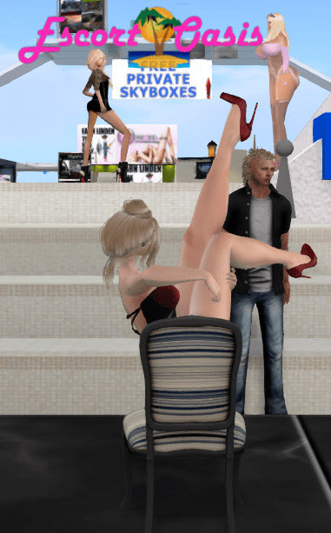
Your Platform Refuses Adult Content
Your metaverse is too small because you refuse to allow adult content
Part of Second Life’s longevity can be attributed to adult content.
Sansar and High Fidelity were hobbled by their rigid refusal to allow adult content (mainly to appeal to corporate clients who never came).
(image credit: RyanSchultz.com blog)
Notes:
Now this is a controversial one: your metaverse is too small because it does not permit adult content.
Now, I do want to state that in some educational applications of the metaverse (especially those intended for children and teenagers i.e. K-12 education), a ban on adult content is necessary. However, in any institution of higher learning (e.g. a university). you will find faculty, staff, and students teaching about, learning about, and doing research on topics which may include controversial or adult topics. I have argued that one of the most significant strategic errors a metaverse platform can make is the outright refusal to host adult content (or do some other sort of heavy-handed sanitization of adult content, like imposing baked-on underwear on the base male and female adult avatars). In my blog, I’ve pointed out that for some successful virtual worlds, adult communities are not just a niche—they are the economic and social engine that keeps the lights on. I have frequently cited Second Life as the prime example of a platform that understands the value of adult content. On my blog, I’ve noted that the adult-rated regions of Second Life generate a good portion of the platform’s revenue through land tier fees and the sale of virtual goods (clothing, skins, animations). In contrast, I wrote about Sansar’s early decision to strictly moderate content and its struggle to establish a clear policy on adult material. I argued that by trying to keep the platform "brand-safe" for corporate partners, they essentially "cut off their nose to spite their face," alienating a potential demographic of creators and consumers who were ready to spend money on higher-fidelity adult experiences. And the corporate clients never came anyway!!
I believe that the ability to explore one’s identity—including its sexual or adult aspects—is fundamental to the metaverse experience. For example, both Second Life and VRChat tend to attract the trans community, giving them a way to experiment with how they represent themselves in a way that might be difficult or impossible to do in real life (particularly at a time when trans people are increasingly under attack in certain jurisdictions). Platforms that ban adult content often end up banning people by extension. If a platform’s moderation is too aggressive, it can lead to the marginalization of subcultures (like the furry community or the trans community) who use virtual worlds as a safe space for exploration. This aligns with Andy’s focus on "presence" and "feeling seen". Andy argues that gathering spaces should be "smaller, weirder," and more human. I have argued that by refusing to host adult content, platforms are choosing "corporate safety" over "human authenticity." They are creating "noise" for brands rather than "spaces that matter" to real people.
One of my core arguments is that you cannot impose a culture on a virtual world; the users bring the culture with them. I’ve pointed out that in almost every successful social VR platform (like VRChat), "NSFW" content and communities exist regardless of official policies. Trying to ban these things is like trying to stop the tide with a broom. Platforms that fight their own communities on this issue usually lose the "heart and soul" that Andy Fidel says is required for a space to be successful. Andy speaks about "architecting belonging" and building spaces like cities. A real-life city has red-light districts, gay bathhouses, private clubs, and adult stores. By refusing to allow these "niche micro-communities" to exist, platform owners are failing to be the architects of a real society and are instead acting as corporate landlords of a sanitized shopping mall.

Slide 31
Thank You
Questions?
Ryan Schultz
Read my blog: https://ryanschultz.com
Join my Discord server: https://discord.com/invite/aMtNVw6V
Notes:
Okay, end of my rant! Thank you for listening. I think that the best way to reach me is to join the 700-odd people on the Discord server attached to my blog at RyanSchultz.com. There’s a link to join the Discord on my website, and I have cut and pasted a join link on this slide. We tend to have some discussions about the metaverse there, and you’re welcome to join us!
We can have a quick Q&A now if there’s time.

